Slide 1


Centralized Operations
Support Hub (COSH)
CPAN/TCHATT
Laurel L. Williams, DO
Edith Ortiz, MBA
Jenn Cole, MBA, LPC-S
PeriPAN
Sarah M. Wakefield, MD
Jenn Erdige, MHA
Aimee Lozano, MHSA

Slide 2


Slide 3

PeriPAN: Enrollment
As of October 31, 2025
• 1286 OB/GYNs
• 308 OB clinics
• 77 Women’s or Maternal Health clinics
• 31 Midwifery practices

Slide 4
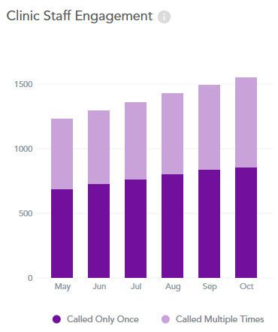
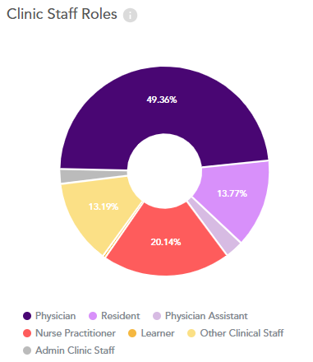
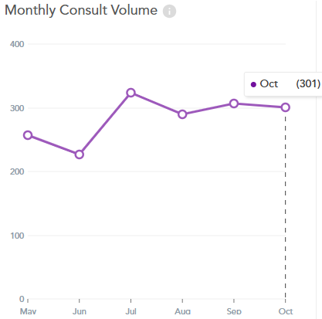
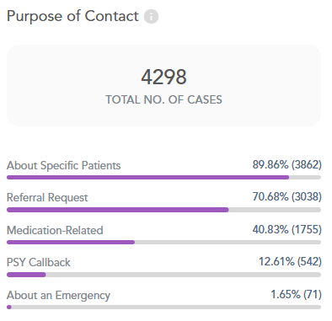
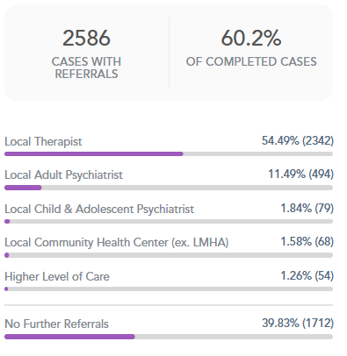
PeriPAN: Consultation Volume & Staff Engagement, as of October 31, 2025

Slide 5
PeriPAN: Total Consultations by Month & Calendar Year as of October 31, 2025
Total Consultations:
2022 – 94
2023 – 551
2024 – 1,648
2025 (to date) – 2,672
Average Monthly Consultations:
2022 – 19
2023 – 46
2024 – 137
2025 (to date) – 267
Statewide Launch
(12 HRIs)
Pilot Begins
(4 HRIs)

Slide 6
PeriPAN: Provider Consultations by Type (Psychiatry & Non-Psychiatry), August 2025 – October 2025

Slide 7
PeriPAN: Direct Patient Consultations by Month as of October 31, 2025

Slide 8
PeriPAN: Percent of Unique Physician Users by Type as of October 31, 2025
To date, physicians account for 67% of unique PeriPAN users.

Slide 9
Completed Projects
HHSC Collaboration - PeriPAN + YOU = Improved Outcomes for Women in Texas
  WHY – Examine the current state of perinatal mental health in Texas
  WHAT – Identify strategies to screen and assess symptoms quickly and consistently
  HOW – Discuss how to incorporate PeriPAN support
ACOG District XI Council & Junior Fellow Council
  Distribution of OB Pocket Card and associated materials
  56 Council and Junior Council OBs attended
MGH National Pregnancy Registry for Psychiatric Medications
  Dr. Marlene Freeman
  Opportunities for support and potential collaborations
  Highlight Postpartum Psychosis Project

Slide 10
Projects in Process
  Pathways- assigning participating hubs to 12 OB clinics in Texas
  Welnity Improvements- Collaborating with HRIs to continue work on Welnity improvements
  HB18 - Collaboration with UTS and other stakeholders to discuss Trayt changes to support rural hospitals
  PeriPAN State CME- 2025 webinar series concluded, preparing promotional materials for 2026; Collaborating with Be Well Texas for MMHSUD ECHO series
  ACOG District XI Texas Residency Program Leadership Roundtable
  Trayt Improvements- Clinician portal beta, Measurement based care for DPC

Slide 11
Trayt:
Beta Provider Portal
Launched October 17th
PeriPAN feedback so far:
“The portal was very helpful for timing. I was able to complete the
request at a time when I wasn't available to talk but could schedule the request for a convenient time.”
“It's a great way to reach out for assistance on your own timeline.”

