Slide 1
Centralized Operations Support Hub
(COSH)
CPAN/TCHATT
Laurel L. Williams, DO
Edith Ortiz, MBA
Jenn Cole, MBA, LPC-S
PeriPAN
Sarah M. Wakefield, MD
Jenn Erdige

Slide 2


Slide 3
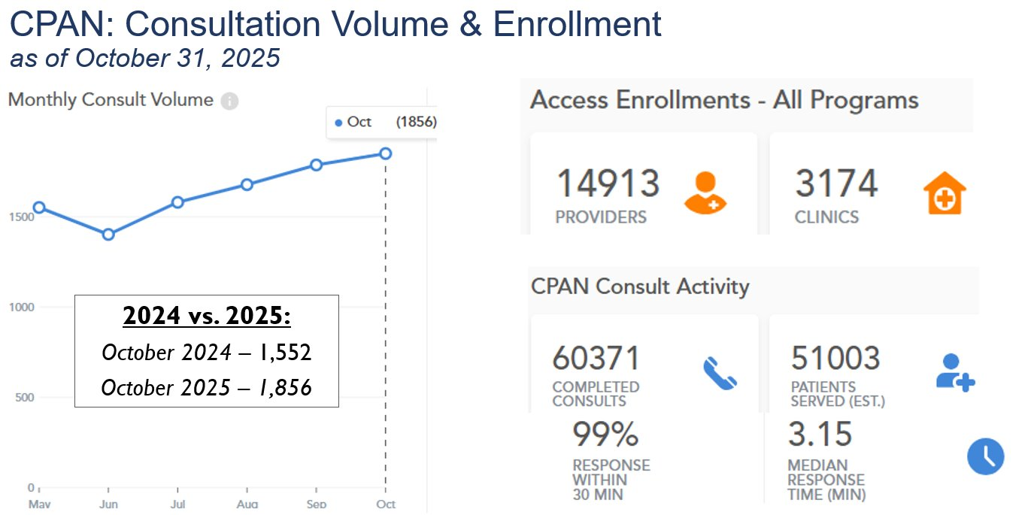

Slide 4
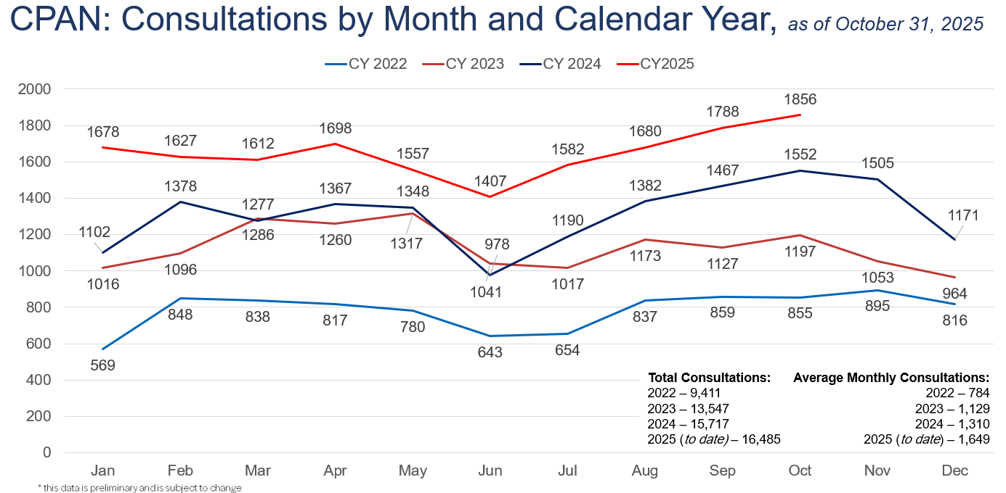

Slide 5
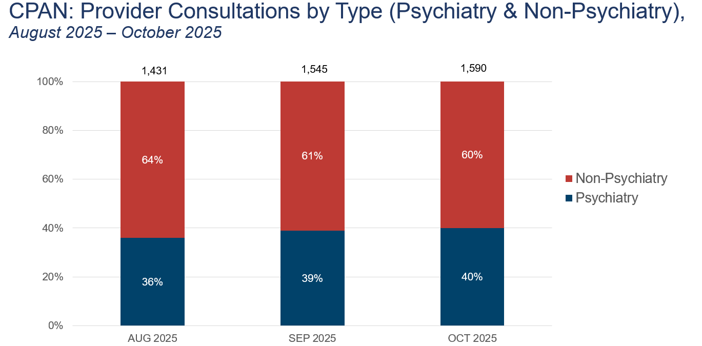

Slide 6
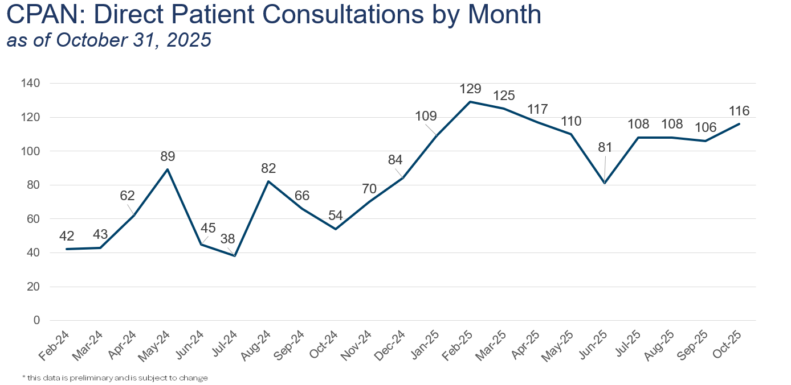

Slide 7
Beta Provider Portal launch: October 17th
  107 users invited to use and provide feedback
  Live demo October 14 & 15
Provider Portal Functionality
  Submit a consultation request
  Access to document sharing
  Assessments to share with patient and families
Next Steps
  Invite additional providers
  Review feedback
  Make updates to portal as needed
  Begin discussion on Portal launch
  Spring 2026
Trayt: Beta Provider Portal

Slide 8
Beta Provider Portal – Feedback
  Feedback received so far:
  "Amazing resource- already CPAN has been an indispensable tool in my care of patients, but this is just another very convenient way to connect with the CPAN team."
  "It's a great way to reach out for assistance on your own timeline."
  "It is an extremely convenient way to request therapy resources as well as Psychiatry consults!"
  " Easy to fit between patients."
  "Easy to use, quick response time."

Slide 9
Projects in Process
  Trayt Improvements- Collaborating with HRIs to continue work on dashboard and DPCs improvements
  Educational workgroup- Reviewing all autism educational resources collected from our subject experts
  Welnity Improvements- Collaborating with HRIs to continue work on Welnity improvements
  HB18 - Collaboration with UTS and other stakeholders to discuss Trayt changes to support rural hospitals
  CPAN State CME- Fall webinars and Project Echo in progress

Slide 10


Slide 11
TCHATT: Referrals as of 10/31/2025
Total Students Referred to the Program – 105,885
* this data is preliminary and is subject to change​
Notes:
99884+6001

Slide 12
TCHATT: Enrollment as of 10/31/2025
* this data is preliminary and is subject to change​

Slide 13
TCHATT: Number of Treatment Sessions and Clients Served by Month, as of 10/31/2025
Notes:
Note. I reduced this to the 2 years prior to this year, but the data is still there to take it to the beginning of the project. It was just getting crowded.

Slide 14
TCHATT: Percent of Sessions by Participating Providers
09/01/2021 – 10/31/2025
Note: More than one provider may participate in a session.
Notes:
This version includes care coordination sessions.

Slide 15
Goal: Increase return of assessments to improve Measurement Based Care
Help create reminders and communications to facilitate better engagement with assessments
Collaborative project with CHC and UTS to help create more engaging outreach
Communications will be customized for each HRI and include family friendly best practice language
Trayt Project:
Assessment Communication Improvement Project

Slide 16
Projects in Process
Presentation Workgroups have been developed to create a presentation library for TCHATT
Collaboration with UTS and other stakeholders to discuss support for rural hospitals and work with HB 18
Continued work with HRIs to support EHR implementation
Collaboration with LMHAs to identify ways to more effectively work with HRIs and increase referrals and education about services
Meet with individual HRIs to discuss intended updates to procedures and possible ways to streamline and improve processes
Continued work on development of Trayt training and procedure materials for SharePoint

