Slide 1
TX-YDSRN: Network Updates
Madhukar Trivedi, MD
Center for Depression Research and Clinical Care
UT Southwestern Medical Center

Slide 2
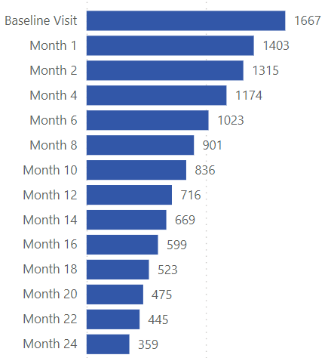
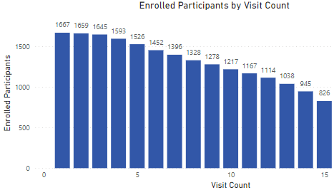
TX-YDSRN Registry Study Status
Node | Enrolled Participants
BCM | 165
TAMU | 109
TTUHSC – El Paso | 112
TTUHSC – Lubbock | 118
UNT/JPS | 271
UT Dell | 169
UT RGV | 51
UTH - Houston | 76
UTH – San Antonio | 165
UTH - Tyler | 22
UTMB | 181
UTSW | 232
Implementation of Protocol Extension In Progress
Total Consented
1869
Total Enrolled
1671
1000+ participants have provided data at 13 or more visits
UNT/JPS and UTSW have enrolled 200+ participants
12,049 total visits completed

Slide 3
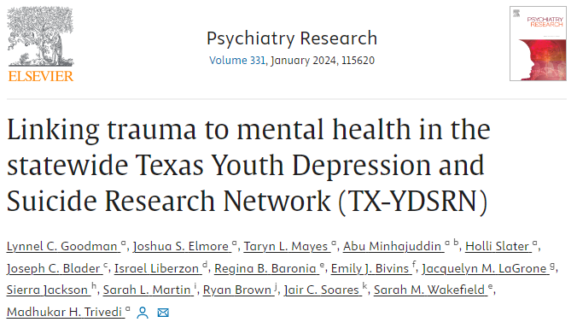
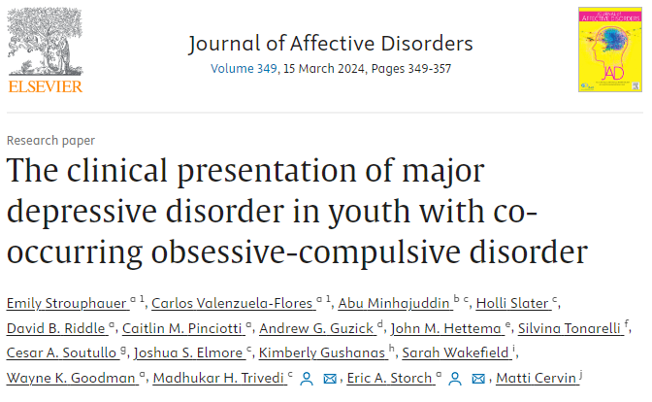
Publications Overview
Published
# 8
54
PROPOSALS SUBMITTED
15
PUBLISHED OR IN PRESS
6 Manuscripts Submitted or Under Review
11 Proposals with Analysis Complete
19 Proposals In Progress
3 Newly Approved Proposals
Published
# 9

Slide 4
Manuscripts: In Press
6
Manuscripts In Press
A Comparison of Depressive Symptom Self-Reported Measures in the Texas Youth Depression and Suicide Research Network (TX-YDSRN) (Nandy, et al., Journal of Clinical Psychiatry)
Measurement Choices for Youth Suicidality (Busby, et al., Child Psychiatry & Human Development)
Characterizing Measurement-Based Care in the Texas Youth Depression and Suicide Research Network (TX-YDSRN) (Slater, et al., Child Psychiatry & Human Development)
Measurement-Based Care for Depression in Youth: Practical Considerations for Selecting Measures to Assess Depression, Associated Features and Functioning (Garza, et al., Special Edition: Child Psychiatry & Human Development)
Data-Driven Subgrouping of Youths with Depression Reveals That Resilience is Associated with Higher Physical Functioning Despite High Symptom Burden in the Texas Youth Depression and Suicide Research Network (TX-YDSRN) (Minhajuddin, et al., Journal of Affective Disorders)
Psychometric Properties of the GAD-7 and PROMIS-Anxiety-4a Among Youth with Depression and Suicidality: Results from the Texas Youth Depression and Suicide Research Network (Guzick, et al., Journal of Psychiatric Research)
Links to all publications are available at https://tx-ydsrn.swmed.org/publication

Slide 5
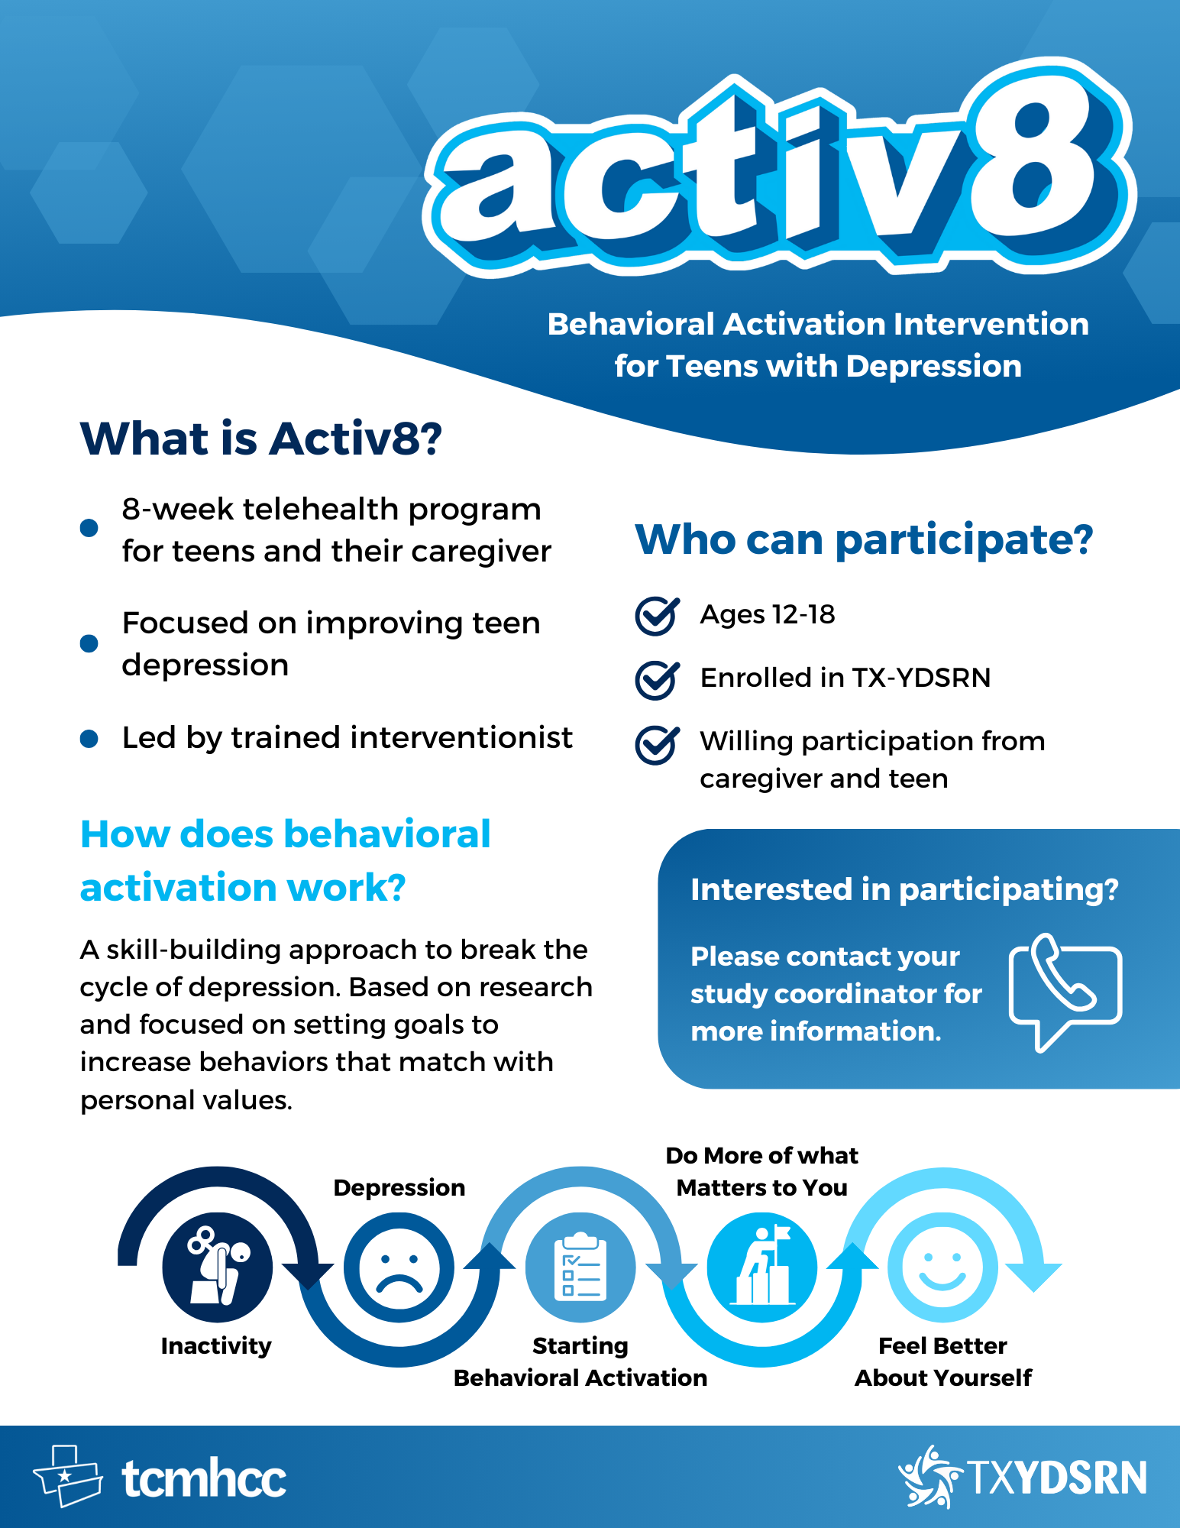
Activ8 for Teens Overview
Officially Launched!
Launched Activ8 SharePoint with tools and resources for interventionists
Developed online training modules for interventionists
Held two in person interventionist trainings
Additional training in January 2024
Trained 13 supervisors
Certified 25 interventionists
Delivered Activ8 materials to Nodes to begin recruitment
Four Nodes Starting Recruitment

Slide 6
Q & A

