Slide 1
YAM Project Updates
Madhukar Trivedi, MD
Center for Depression Research and Clinical Care
UT Southwestern Medical Center

Slide 2
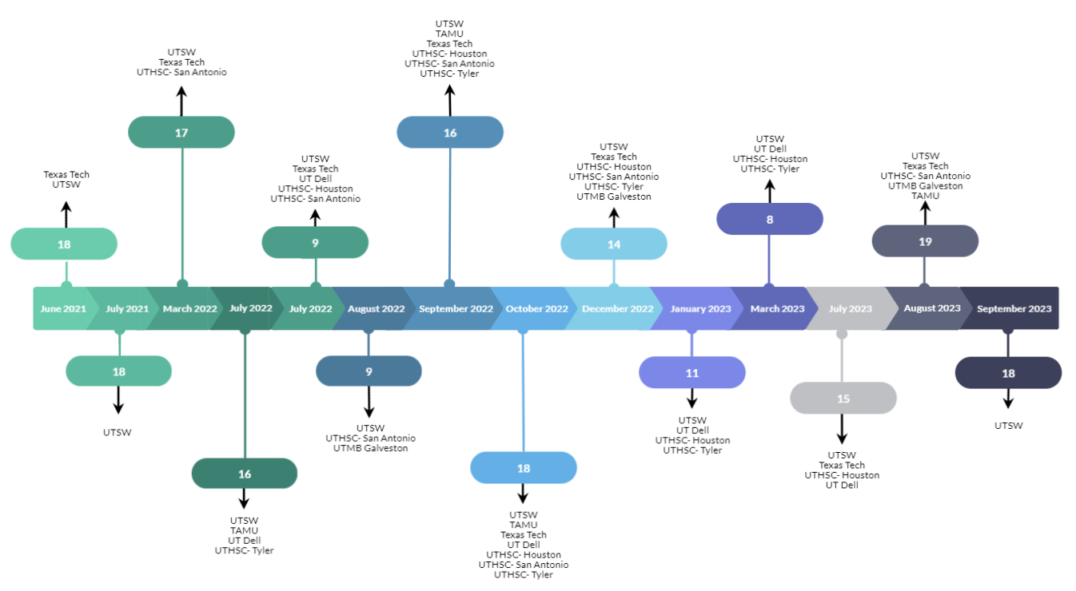
Progress: 206 Instructors Trained Over 14 Sessions

Slide 3
MOU’s Signed by Region as of December 2023
UTSW | UTHSC- Tyler | Texas Tech | UT Dell
17 | 32 | 44 | 40
EC - 12th Grade Student Population for all MOU’s
177,925 | 17,866 | 16,060 | 264,080
UTHSC- Houston | UTMB- Galveston | UTHSC- San Antonio | TAMU
15 | 13 | 20 | 6
EC - 12th Grade Student Population for all MOU’s
336,220 | 40,247 | 74,502 | 5,294
933,971
Total Across All Regions =

Slide 4
Texas YAM Student Reach
(UTSW & Texas Tech started implementation in Spring 2022, the additional HRIs joined the effort in Fall 2022)
N = 23,559 to date
Projected Total Reach
End of 2023-2024 SY
35,000
Note: UTSW began implementing YAM, building the team, and establishing relationships with schools in 2016.

Slide 5
YAM Student Classes
(UTSW & Texas Tech started implementation in Spring 2022, the additional HRIs joined the effort in Fall 2022)
N = 1,202 to date
Projected Total Classes
End of 2023-2024 SY
2,000
Note: UTSW began implementing YAM, building the team, and establishing relationships with schools in 2016.

Slide 6
117,795
Texas students have spent
hours participating in YAM since Spring 2022

