Slide 1
TCMHCC Brand Update

Slide 2
Logo

Slide 3
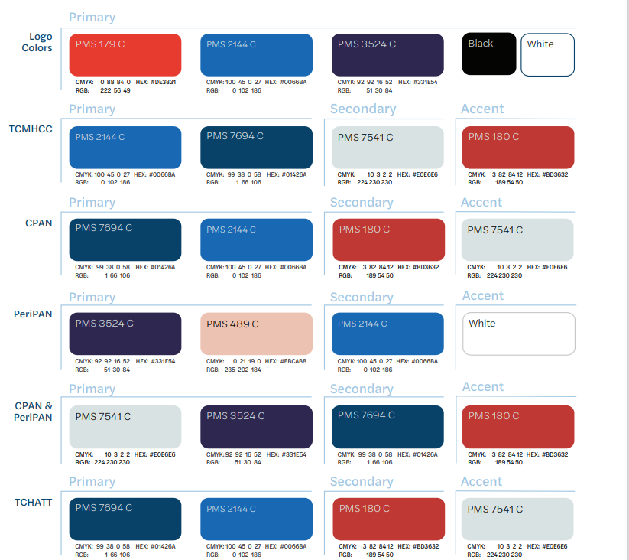
Colors

Slide 4
Questions?

