Slide 1
PeriPAN
Sarah Mallard Wakefield, MD
Medical Director of PeriPAN
Associate Professor and Chair of Psychiatry
School of Medicine, TTUHSC

Slide 2
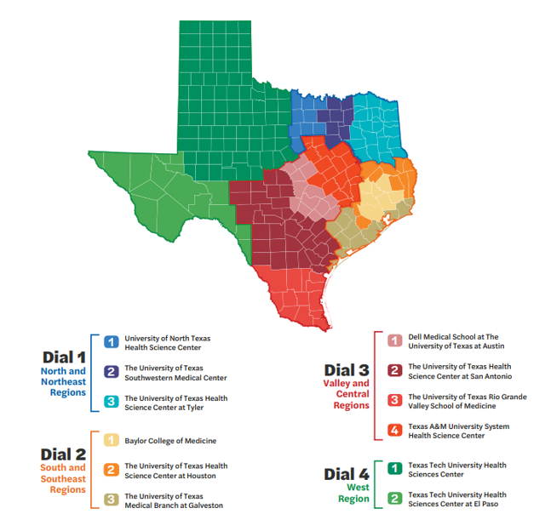
Coverage Map

Slide 3
PeriPAN Updates
Regional OB list distribution to all 12 HRI’s
  Updated lists to pilot sites
  Initial lists to incoming sites
Collaboration continues with Lifeline for Moms and the Center for Healthcare Communication
  Outreach and engagement
  Enrollment
Social Media: posts shared on established CPAN pages
Direct Consults available statewide
Statewide Launch
September 1, 2023

Slide 4
PeriPAN Grand Rounds Schedule
2023
3rd Tuesday of the month
12:00-1:00
Date & Time | Topic
10/17/2023 12:00- 1:00 PM | Perinatal and Postpartum Psychosis
11/21/2023 12:00- 1:00 PM | NICU Parent Supports and Considerations
12/19/2023 12:00- 1:00 PM | Paternal Mental Health and the Perinatal-Postpartum Periods

Slide 5
Date & Time | Topic
1/16/2024 | Introduction to Perinatal Mood and Anxiety Disorders
2/20/2024 | Screening and Diagnosis of Anxiety and Depression in Pregnancy and the Postpartum Period
3/19/2024 | Screening and Diagnosis of Bipolar and Schizophrenia Spectrum in the Pregnancy and Postpartum Period
4/16/2024 | Suicide Risk and Safety Assessment in Perinatal Mental Health
5/21/2024 | Psychotropic Medication in Breastfeeding and Pregnancy
6/18/2024 | Psychopharmacology and Perinatal Mood and Anxiety Disorders
7/16/2024 | Substance Use in the Perinatal and Postpartum Periods
8/20/2024 | Eating Disorders and Perinatal Mental Health
9/17/2024 | Perinatal and Postpartum Psychosis
10/15/2024 | NICU Parent Supports and Considerations
11/19/2024 | Paternal Mental Health and the Perinatal-Postpartum Periods
1/16/2024 | Introduction to Perinatal Mood and Anxiety Disorders
PeriPAN Grand Rounds Schedule
2024
3rd Tuesday of the month
12:00-1:00

Slide 6
PeriPAN ECHO | Fall 2023
Tuesday’s 12:00-1:00
Date | Topic
9/26/23 | Introduction to ECHO® and Perinatal Mental Health Consultation
10/10/23 | Postpartum Psychosis
10/24/23 | Substance Use in the Perinatal and Postpartum Period
11/7/23 | Perinatal OCD
11/28/23 | Trauma-Informed Care and PMAD
12/5/23 | Eating Disorders and Perinatal Mental Health
12/12/23 | Sleep Hygiene and Perinatal Mental Health

