Slide 1
PeriPAN
Sarah Mallard Wakefield, MD
Medical Director of PeriPAN
Associate Professor and Chair of Psychiatry
School of Medicine, TTUHSC

Slide 2
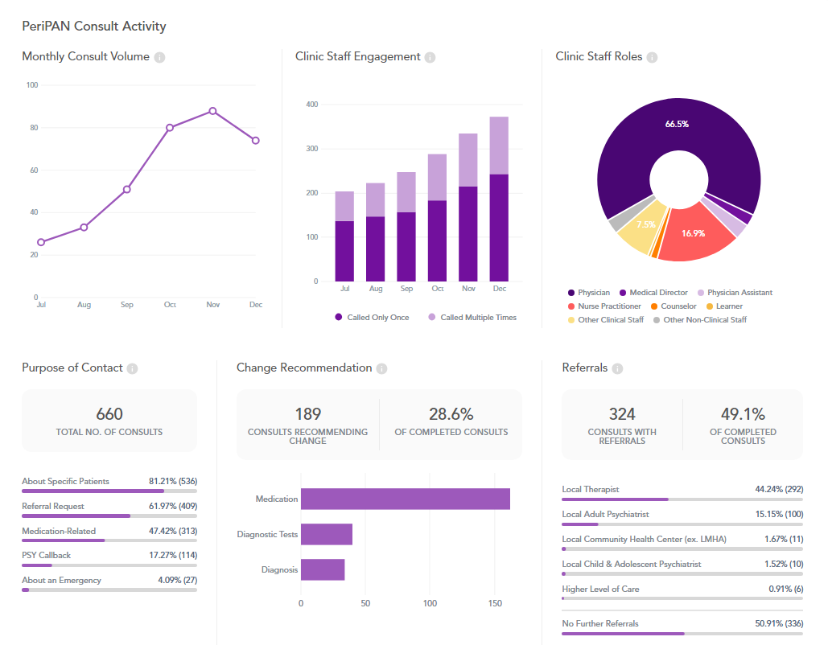
PeriPAN Activity

Slide 3
Physician Call Activity
Physicians: 67% of calls

Slide 4
PeriPAN Enrollment Activity

Slide 5
PeriPAN ECHO | Spring 2024
Tuesday’s 12:00-1:00
Date | Topic
3/12/2024 | Introduction to ECHO® and Perinatal Mental Health Consultation
3/26/2024 | Intrusive Thoughts vs. Psychosis in the Perinatal/Postpartum Period
4/9/2024 | Cultural Considerations in Perinatal Mental Health
4/23/2024 | Mental Health and Infertility Challenges
5/7/2024 | Perinatal Loss
5/28/2024 | Hyperemesis Gravidarum
6/4/2024 | Postpartum Catatonia

Slide 6
Date & Time | Topic
1/16/2024 | Introduction to Perinatal Mood and Anxiety Disorders
2/20/2024 | Screening and Diagnosis of Bipolar and Schizophrenia Spectrum in the Pregnancy and Postpartum Period
3/19/2024 | Screening and Diagnosis of Anxiety and Depression in Pregnancy and the Postpartum Period
4/16/2024 | Suicide Risk and Safety Assessment in Perinatal Mental Health
5/21/2024 | Psychotropic Medication in Breastfeeding and Pregnancy
6/18/2024 | Psychopharmacology and Perinatal Mood and Anxiety Disorders
7/16/2024 | Substance Use in the Perinatal and Postpartum Periods
8/20/2024 | Eating Disorders and Perinatal Mental Health
9/17/2024 | Perinatal and Postpartum Psychosis
10/15/2024 | NICU Parent Supports and Considerations
11/19/2024 | Paternal Mental Health and the Perinatal-Postpartum Periods
PeriPAN Grand Rounds Schedule
2024
3rd Tuesday of the month
12:00-1:00

Slide 7
MMHSUD HRSA Grant: PeriPAN Collaboration
Current situation: in 2019, substance use disorder (SUD) contributed to 11% of pregnancy-related deaths
Be Well, Texas
  Goal: Eradicate substance-related deaths, reduce morbidity, and improve health
  Despite efforts, SUD continues to be a difficult issue to address because of various factors
  Factors influencing Access
    challenges to recovery
      Complex needs and trauma
      Child welfare involvement
      Loss of a loved one
      Limited social support
      Interpersonal conflict and abuse
      Unaddressed mental illness
    Lack of workforce
For these reasons, PeriPAN joined HHSC in their application for the MMHSUD grant as the next step in working to address this issue
Perinatal Substance Use:
A Solution for Texas

Slide 8
State Efforts and Solutions
2011-2015
HOPES (Healthy Outcomes through Prevention and Early Support)
2016-2020
Casa Mia
2021-Today
House Bill 12
Mommies Model
Opioid Treatment Expansion
Pregnancy Stabilization Center
Healthy Texas Women Plus
High-Risk Maternal Care Coordination Services Pilot
Maternal Opioid Misuse Model
Recovery Residence Housing
TexasAIM Opioid Use Disorder Bundle
Integrated Family Planning and Opioid Response
Perinatal Psychiatry Access Network
Strategic Action Partnership to Reduce Violent Pregnancy-Associated Deaths
Screening and Treatment for Maternal Mental Health and Substance Use Disorders

Slide 9
Texas MMHSUD Goals
Characteristics:
Establishes linkage between PeriPAN and referral to substance use services in Texas when indicated
Statewide implementation
Focusing on women with SUD
Goal 1: Build the capacity of Texas’ perinatal workforce to enable routine MMHSUD screening for pregnant and postpartum women, especially women living in underserved communities and women living in under-resourced rural areas.
Goal 2: Increase access to real-time psychiatric consultation and substance use disorder screening, treatment, and recovery support resources for the perinatal workforce. Pregnant and postpartum women will be able to obtain in-person or telehealth care from providers in the Be Well Texas Recovery Network and the Be Well Texas Clinic.
Goal 3: Increase access to trauma-informed, culturally, and linguistically appropriate psychiatric or substance use disorder treatment and recovery support services for pregnant and postpartum women.

Slide 10
Pathways to Perinatal Mental Health Equity Study
Pathways and PeriPAN
Lifeline for Moms

Slide 11
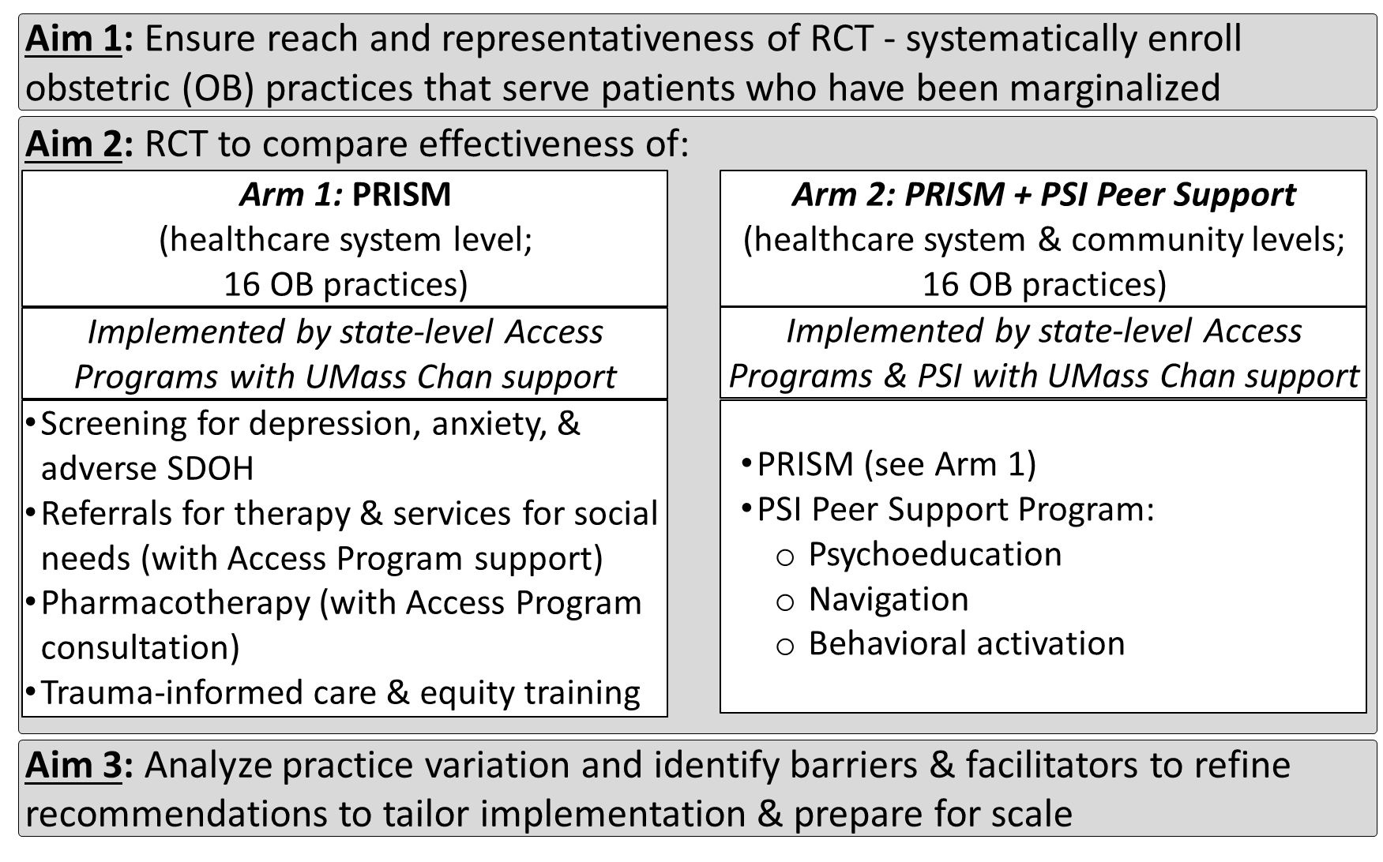
We will compare our Healthcare System approach to Healthcare-Community Partnership

Slide 12
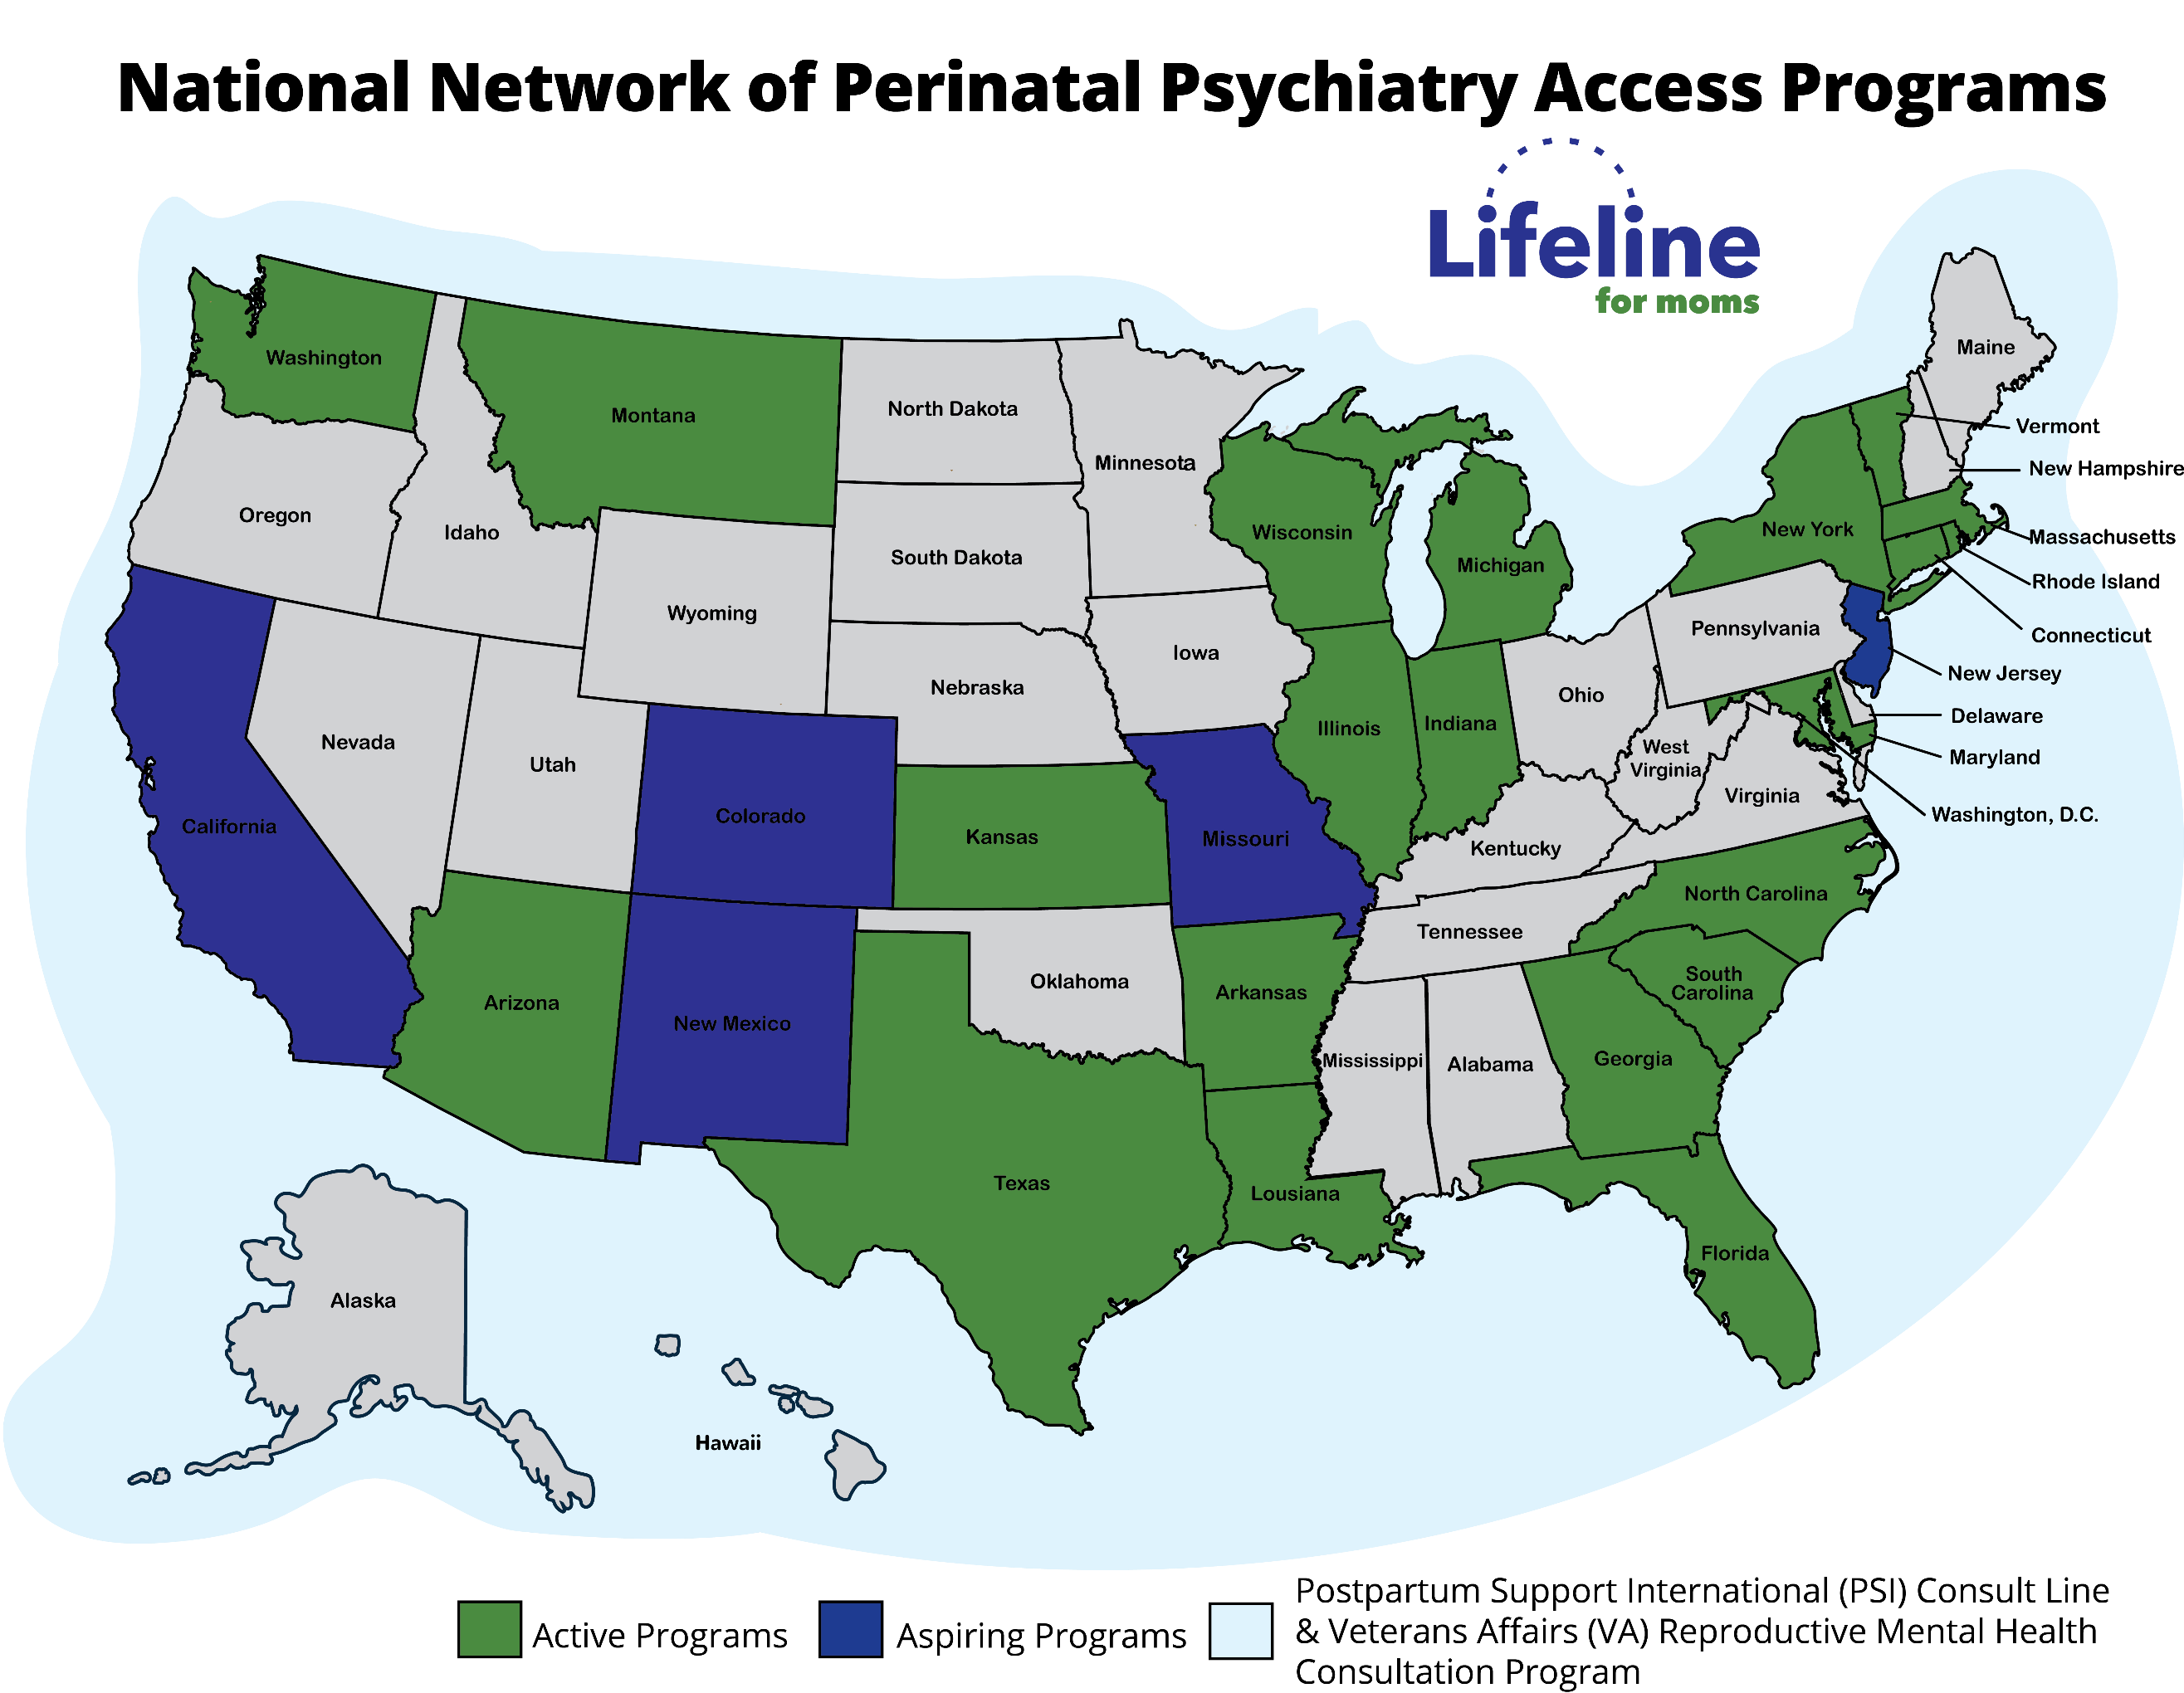
In Pathways, we will partner with Access Programs team to support them doing their own implementation with obstetric practices
Planning
Implementation
Sustainment
1
2
3
4
5
6
7
8
9
10

Slide 13
Each Access Program will be a clinical and academic partner
7-8 states will do virtual implementation, each Access Program will implement PRISM with 4-8 practices per state
There is grant support for each Access Program and obstetric practice
There will be many opportunities for clinical and academic partnership:
    Authorship on papers
    New studies
    Program evaluation
    Analyses at the Access Program level

Slide 14
Snapshot of Project Timeline
Project start date: 3/1/24
Planning Phase 1: until 2/28/25
Research Phase 2 – 5 years: 3/1/25 – 2/28/30
Project End date: 2/28/31
Anticipated Implementation Timeline
PRISM Implementation – Fall of 2025
PRISM + PSI Peer Support Implementation – Spring of 2026

