Slide 1
Perinatal Psychiatry Access Network (PeriPAN)
Sarah Mallard Wakefield, MD
Medical Director of PeriPAN
Associate Professor and Chair of Psychiatry
School of Medicine, TTUHSC

Slide 2
PeriPAN Enrollment - 899 OBs - 164 OB clinics - 44 Women’s or Maternal Health clinics - 13 Midwifery practices

Slide 3
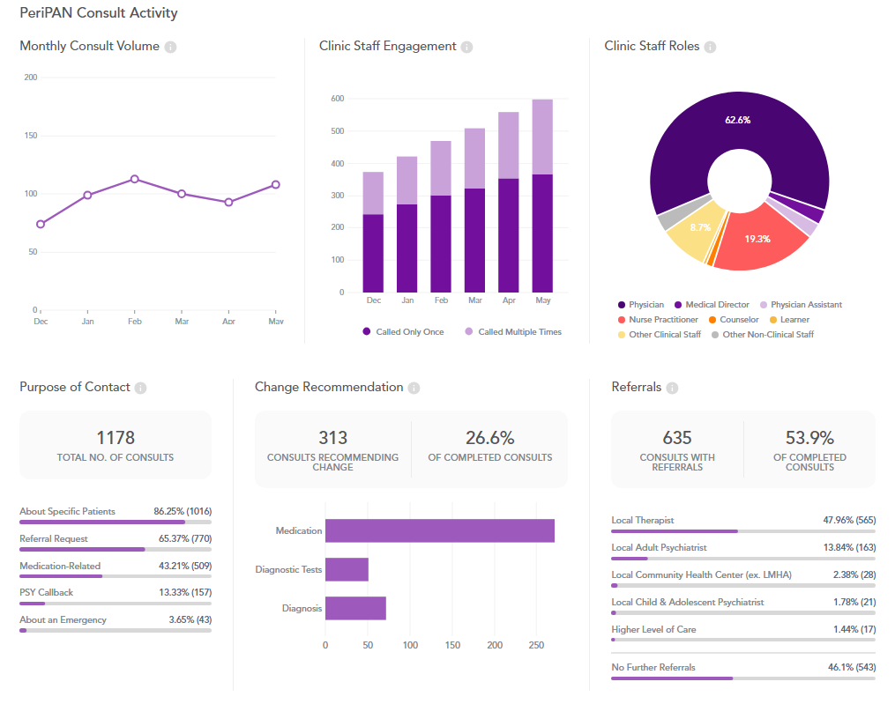
PeriPAN Activity
May 2024

Slide 4
Consult Activity: Physician 66% of calls

Slide 5
April - May 2024 PeriPAN Consultations
* this data is preliminary and is subject to change​

Slide 6
Date & Time | Topic
1/16/2024 | Introduction to Perinatal Mood and Anxiety Disorders
2/20/2024 | Screening and Diagnosis of Bipolar and Schizophrenia Spectrum in the Pregnancy and Postpartum Period
3/19/2024 | Screening and Diagnosis of Anxiety and Depression in Pregnancy and the Postpartum Period
4/16/2024 | Suicide Risk and Safety Assessment in Perinatal Mental Health
5/21/2024 | Psychotropic Medication in Breastfeeding and Pregnancy
6/18/2024 | Psychopharmacology and Perinatal Mood and Anxiety Disorders
7/16/2024 | Substance Use in the Perinatal and Postpartum Periods
8/20/2024 | Eating Disorders and Perinatal Mental Health
9/17/2024 | Perinatal and Postpartum Psychosis
10/15/2024 | NICU Parent Supports and Considerations
11/19/2024 | Paternal Mental Health and the Perinatal-Postpartum Periods
PeriPAN Grand Rounds Schedule
2024
3rd Tuesday of the month
12:00-1:00 CT

Slide 7
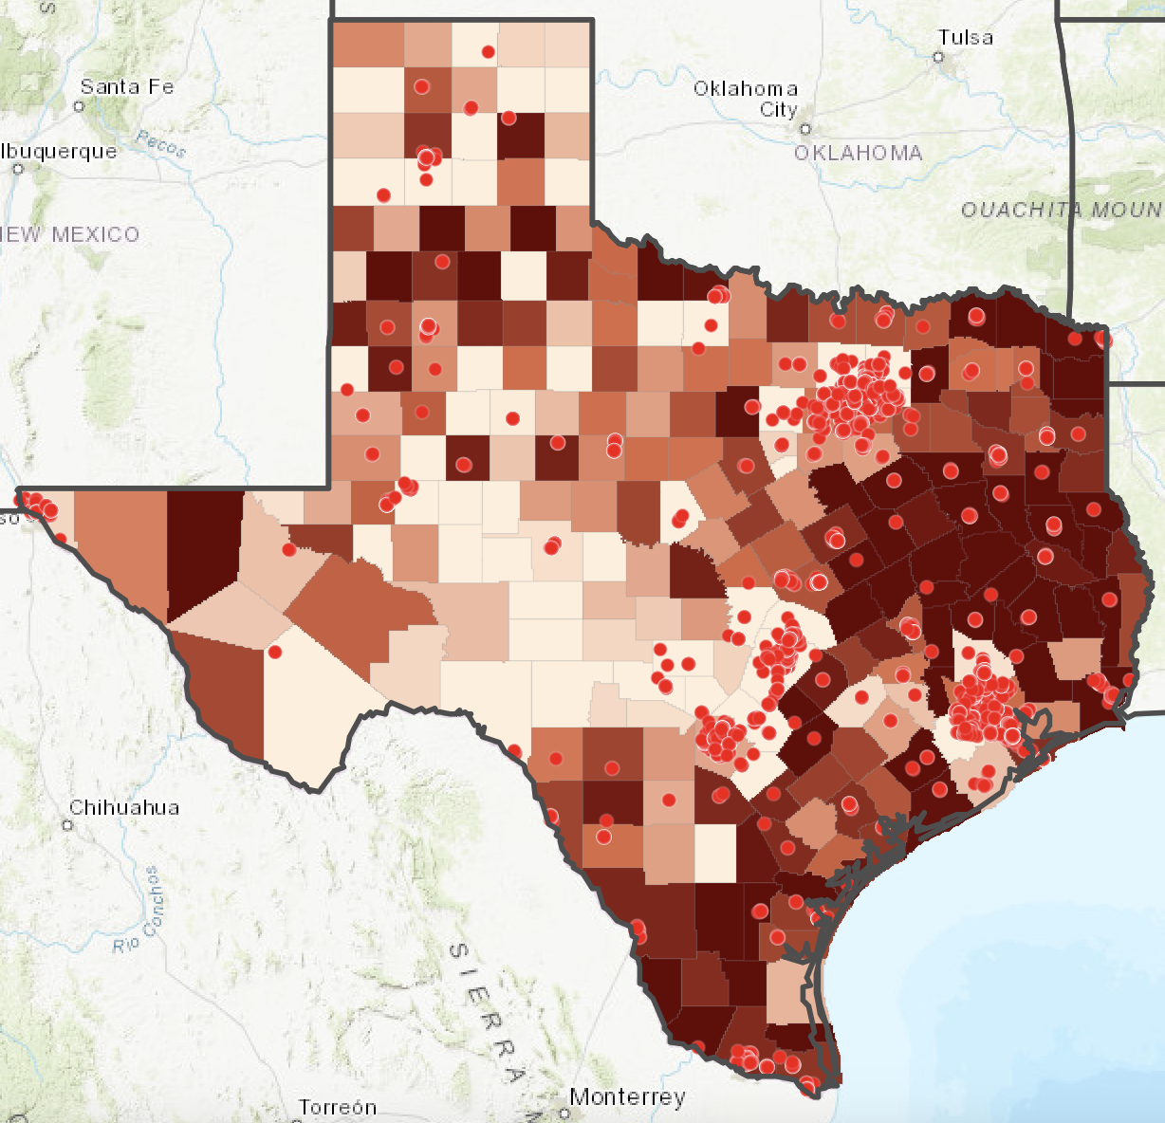
PeriPAN Collaboration Updates
ACOG and PeriPAN
Pathways to Perinatal Mental Health Equity (Pathways)
Postpartum Depression ECHO Launch
PeriPAN Toolkit Webinar available
Scan QR code to access
District XI Annual District Meeting: Council meeting with residents
Geographic & practice selection
OB practice recruitment
Collaborating with TexasAIM and TCHMB
ECHO series will run 6/11/24 -10/8/24
Registration: https://www.surveymonkey.com/r/N8DNY2C

Slide 8
PeriPAN/TPS ECHO Schedule
Summer/Fall
2024
2nd and 4th Tuesday of the month
12:00-1:00 CT
Date & Time | Topic
6/11/2024 | Introduction to ECHO
6/25/2024 | Introduction to Postpartum Depression Screening
7/9/2024 | Screening Tools and Assessment
7/23/2024 | Implementation strategies in Pediatric Practice
8/13/2024 | Communication and Support for Families
8/27/2024 | Collaborative Care and Referral Networks- Provider-facing and mother-facing
9/10/2024 | Billing, Coding, and Reimbursement for PPD Screening Services/ Advocacy and Policy
9/24/2024 | Non-maternal caregivers and depression
10/8/2024 | Maternal Well-Being

