Slide 1
Perinatal Psychiatry Access Network (PeriPAN)
Sarah Mallard Wakefield, MD
Medical Director of PeriPAN
Associate Professor and Chair of Psychiatry
School of Medicine, TTUHSC

Slide 2
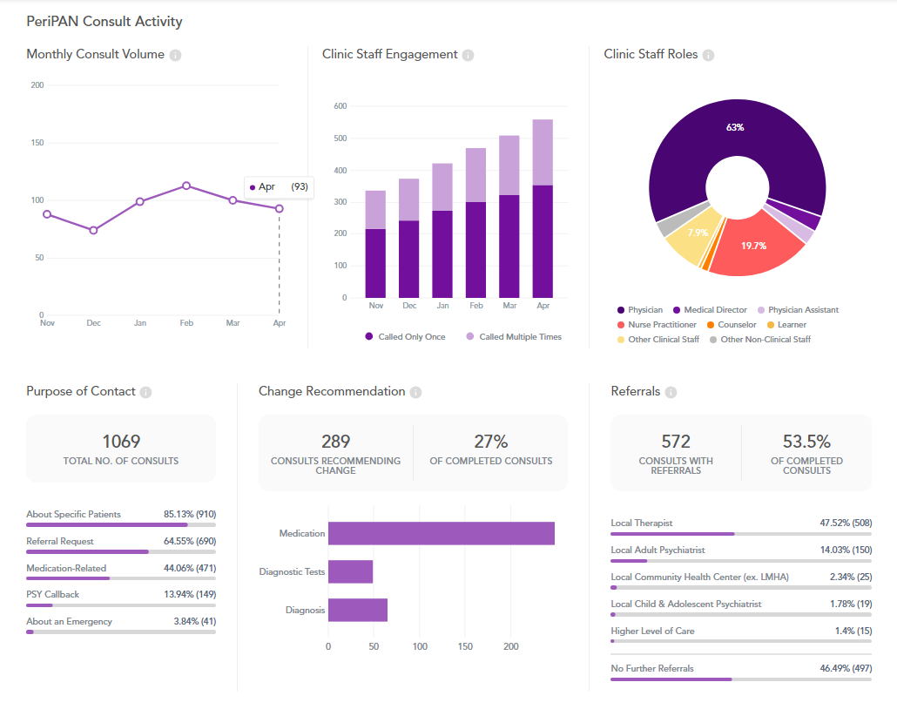
PeriPAN Activity
April 2024

Slide 3
April Consult Activity: Physician 66% of calls Other clinic roles consult activity 34% of calls  Nurse Practitioner – 110  Certified Midwife – 24  Physician Assistant – 14

Slide 4
Date & Time | Topic
1/16/2024 | Introduction to Perinatal Mood and Anxiety Disorders
2/20/2024 | Screening and Diagnosis of Bipolar and Schizophrenia Spectrum in the Pregnancy and Postpartum Period
3/19/2024 | Screening and Diagnosis of Anxiety and Depression in Pregnancy and the Postpartum Period
4/16/2024 | Suicide Risk and Safety Assessment in Perinatal Mental Health
5/21/2024 | Psychotropic Medication in Breastfeeding and Pregnancy
6/18/2024 | Psychopharmacology and Perinatal Mood and Anxiety Disorders
7/16/2024 | Substance Use in the Perinatal and Postpartum Periods
8/20/2024 | Eating Disorders and Perinatal Mental Health
9/17/2024 | Perinatal and Postpartum Psychosis
10/15/2024 | NICU Parent Supports and Considerations
11/19/2024 | Paternal Mental Health and the Perinatal-Postpartum Periods
PeriPAN Grand Rounds Schedule
2024
3rd Tuesday of the month
12:00-1:00

Slide 5
PeriPAN ECHO | Spring 2024 Tuesday’s 12:00-1:00
Date | Topic
3/12/2024 | Introduction to ECHO® and Perinatal Mental Health Consultation
3/26/2024 | Intrusive Thoughts vs. Psychosis in the Perinatal/Postpartum Period
4/9/2024 | Cultural Considerations in Perinatal Mental Health
4/23/2024 | Mental Health and Infertility Challenges
5/7/2024 | Perinatal Loss
5/28/2024 | Hyperemesis Gravidarum
6/4/2024 | Postpartum Catatonia

Slide 6
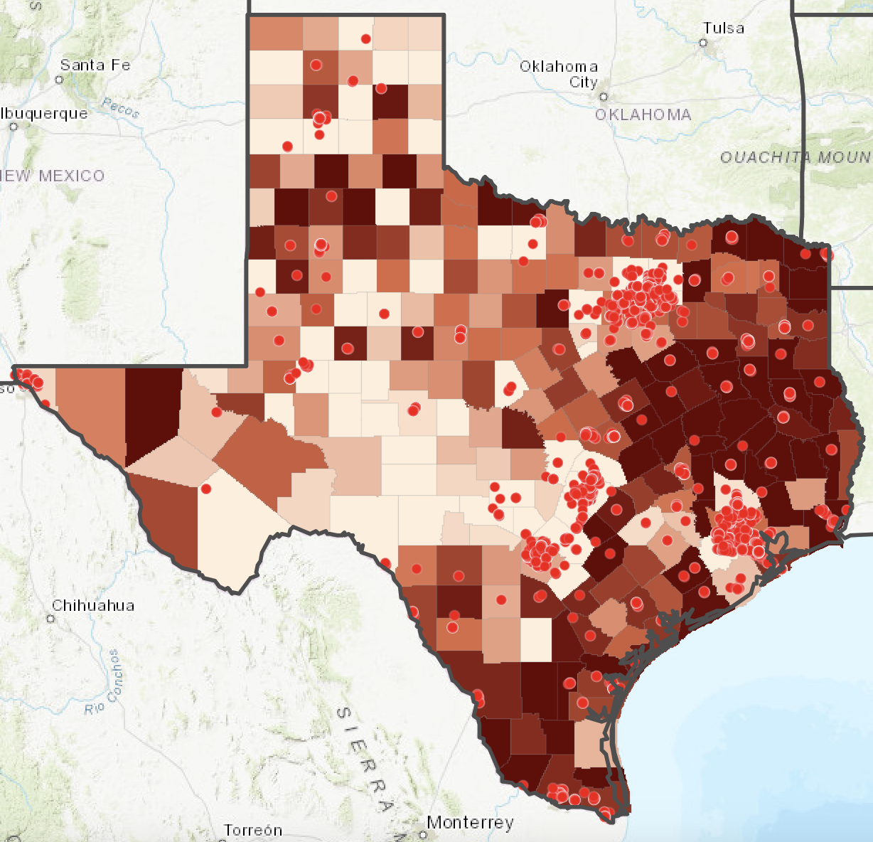
PeriPAN Updates
Postpartum Depression (PPD) Workgroup
Pathways to Perinatal Mental Health Equity (Pathways)
April Enrollment
ECHO series 6/11/24 -10/8/24
Offered on the 2nd and 4th Tuesday of the month at noon
Registration and topic information available shortly
Geographic & practice selection
OB practice recruitment
Collaborating with TexasAIM and TCHMB
875 OBs
164 OB clinics
41 Women’s or Maternal Health clinics
13 Midwifery practices

