Slide 1
PeriPAN
Sarah Mallard Wakefield, MD
Medical Director of PeriPAN
Associate Professor and Chair of Psychiatry
School of Medicine, TTUHSC

Slide 2
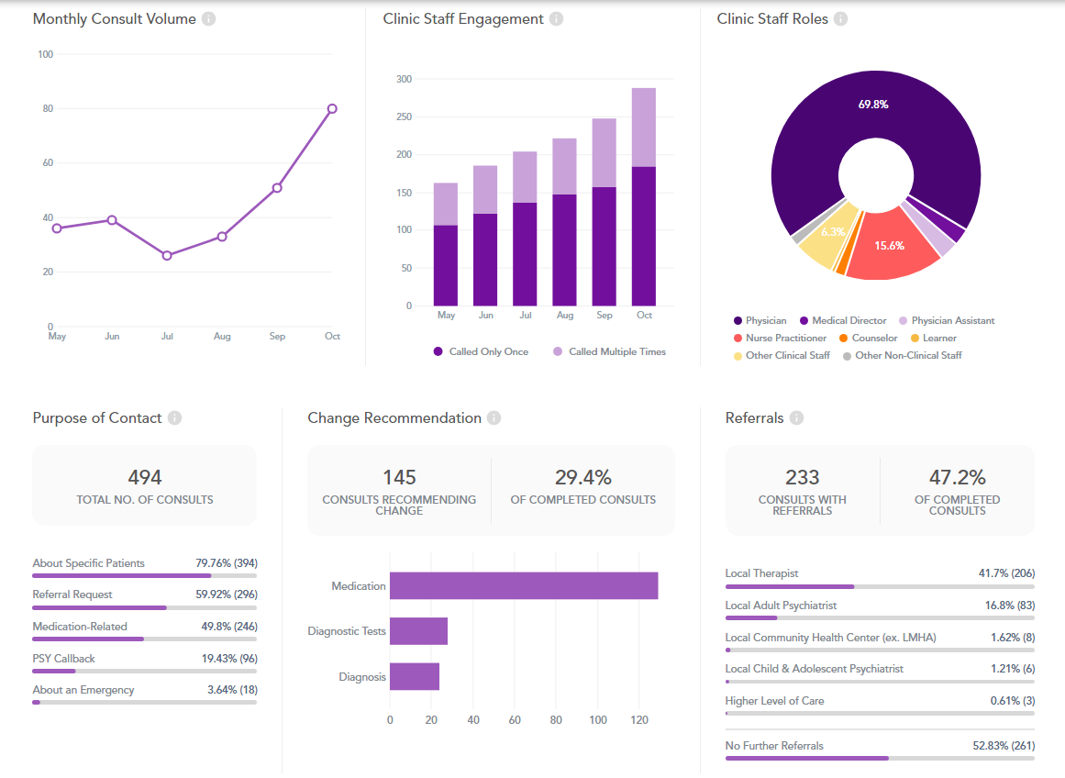
PeriPAN Activity

Slide 3
Physician Call Activity
Physicians: 70% of calls

Slide 4
PeriPAN Enrollment Activity

Slide 5
PeriPAN ECHO | Fall 2023
Tuesday’s 12:00-1:00
Date | Topic
9/26/23 | Introduction to ECHO® and Perinatal Mental Health Consultation
10/10/23 | Postpartum Psychosis
10/24/23 | Substance Use in the Perinatal and Postpartum Period
11/7/23 | Perinatal OCD
11/28/23 | Trauma-Informed Care and PMAD
12/5/23 | Eating Disorders and Perinatal Mental Health
12/12/23 | Sleep Hygiene and Perinatal Mental Health

Slide 6
PeriPAN Grand Rounds Schedule
2023
3rd Tuesday of the month
12:00-1:00
Date & Time | Topic
11/21/2023 12:00- 1:00 PM | NICU Parent Supports and Considerations
12/19/2023 12:00- 1:00 PM | Paternal Mental Health and the Perinatal-Postpartum Periods

Slide 7
Date & Time | Topic
1/16/2024 | Introduction to Perinatal Mood and Anxiety Disorders
2/20/2024 | Screening and Diagnosis of Bipolar and Schizophrenia Spectrum in the Pregnancy and Postpartum Period
3/19/2024 | Screening and Diagnosis of Anxiety and Depression in Pregnancy and the Postpartum Period
4/16/2024 | Suicide Risk and Safety Assessment in Perinatal Mental Health
5/21/2024 | Psychotropic Medication in Breastfeeding and Pregnancy
6/18/2024 | Psychopharmacology and Perinatal Mood and Anxiety Disorders
7/16/2024 | Substance Use in the Perinatal and Postpartum Periods
8/20/2024 | Eating Disorders and Perinatal Mental Health
9/17/2024 | Perinatal and Postpartum Psychosis
10/15/2024 | NICU Parent Supports and Considerations
11/19/2024 | Paternal Mental Health and the Perinatal-Postpartum Periods
PeriPAN Grand Rounds Schedule
2024
3rd Tuesday of the month
12:00-1:00

