Slide 1
Internal Evaluation Updates
February 19, 2024

Slide 2
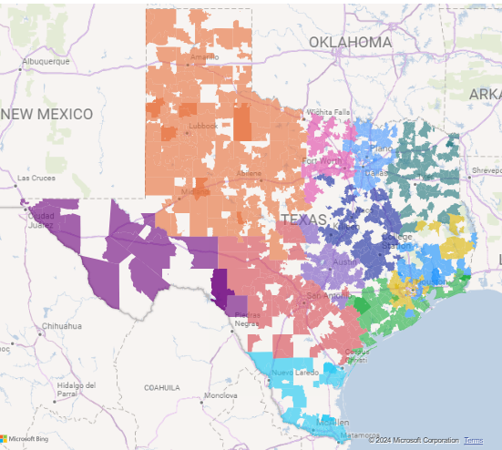
TCHATT Campuses Active in December 2023
3,867,170
70.3%
Number of Students Able to Access TCHATT Care
Total Proportion of Student Lives Covered by TCHATT
778
6,154
Number of School Districts Enrolled
Number of School Campuses Enrolled
Notes:
3867170 active
565044 declined
31118 inactive
390334 unresponsive
275318 planned
167410 onboarding
207333 pending
5504270 total census

Slide 3
Exploring Enrollment Further
Notes:
DIVE INTO UNCOVERED SCHOOLS – WHO IS REALLY LEFT TO COVER
4 HRIS HAVE NO REMAINING STUDENTS IN THE “PLANNED” STATUS – CELEBRATE THEM
UNTHSC
UTHSCSA
UTMB
UTSWMC
ALL OTHERS ARE UNDER 15% REMAINING

Slide 4
TCHATT Sessions by Month – Growth by Program Years
Notes:
How many days it is taking to get enrolled
How many they are seeing past 5 sessions
How many are seen after 5:00

Slide 5
Number of Encounters Provided through TCHATT
Number of Encounters
Notes:
Data through 1/31/2024
Encounters exclude those that are solely care coordination.

Slide 6
Honestly, we had a great experience with my daughter’s counselor, and she has overcome some things she struggled with in the past so TCHATT helped us!!! I wouldn't change a thing.
Please have weekends and times passed [sic] 5pm would be very helpful for parents to attend more sessions.
I really hoped that my child and her provider could meet a little longer.
I can’t say enough great things about this program.

