Slide 1
January 16, 2024
Arpa sb 8 section 8
fiscal agent – UT Austin
Linda haster
Associate Director of Grants Financial Management
Office of Sponsored Projects (OSP)
The University of Texas at Austin

Slide 2
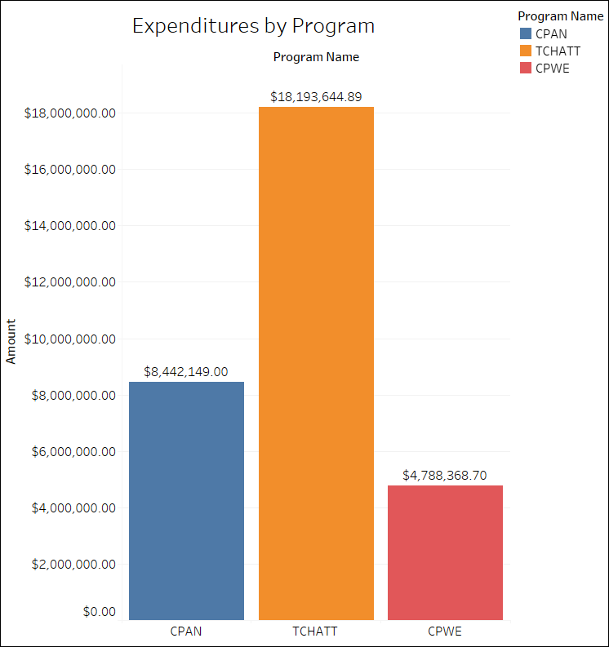

Slide 3
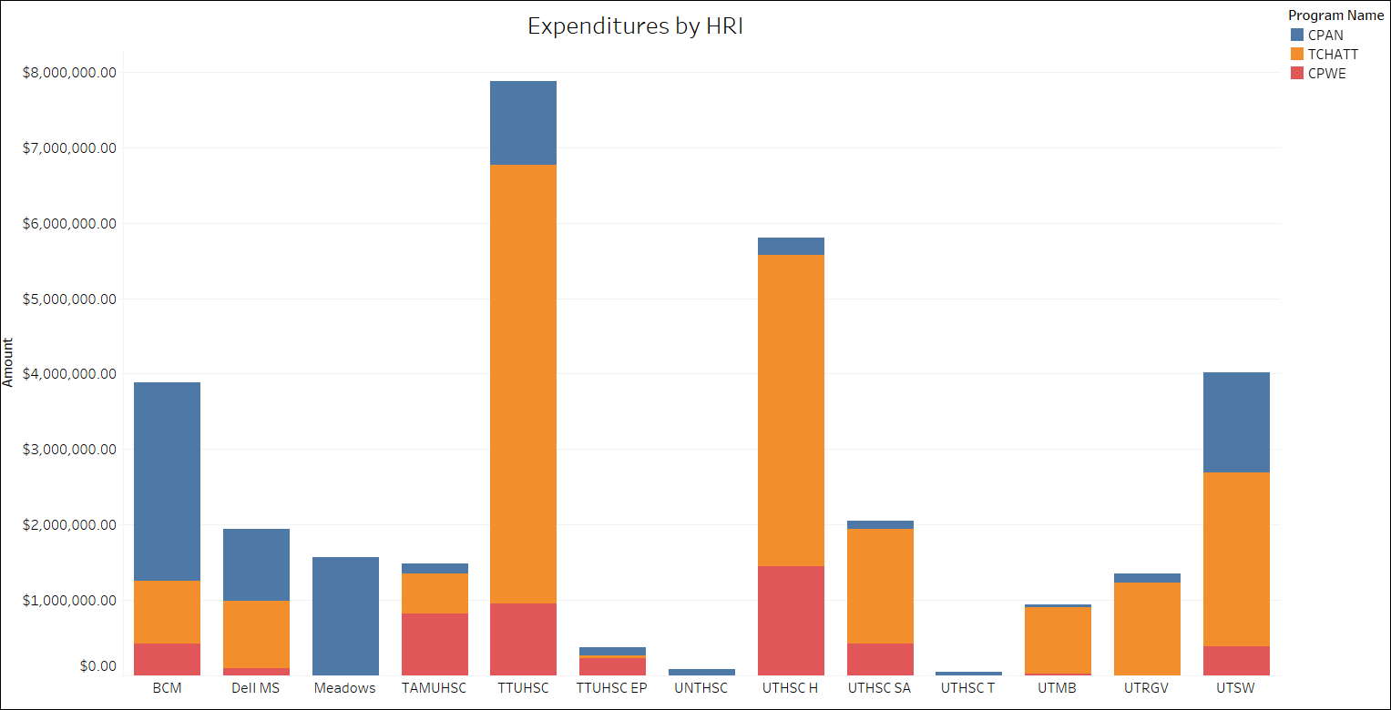

Slide 4
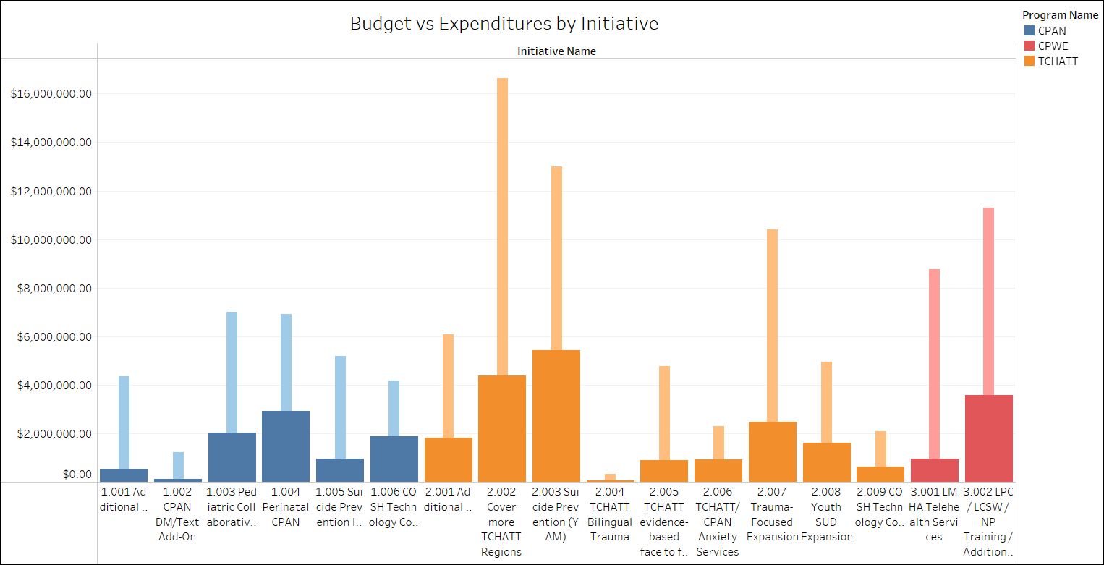

Slide 5
Contact Information
Linda Haster, Authorized Official
linda.haster@austin.utexas.edu
Joy Hatch, Financial Contact
joyhatch@austin.utexas.edu
Laura Ochoa, Administrative Contact
ochoa@austin.utexas.edu
Rachael Holt, Administrative Associate
rachael.holt@austin.utexas.edu
Process sub-award reimbursements

