Slide 1
TCMHCC External Evaluation October 2023

Slide 2
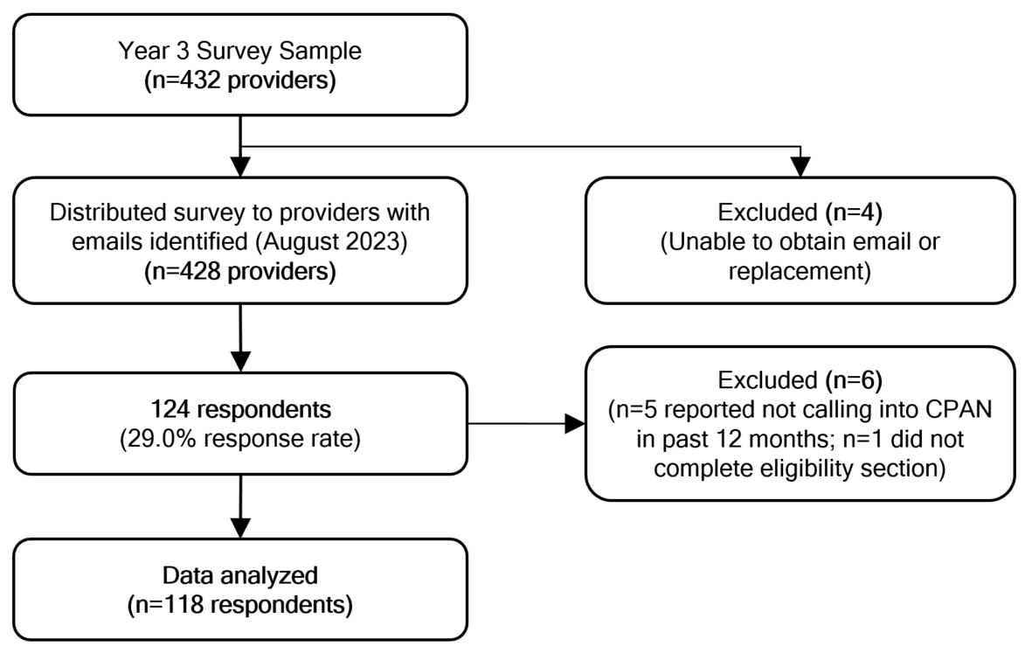
CPAN Provider Survey (Active Users)
Objective: Adapt and deliver CPAN
survey to enrolled providers who have used CPAN in the past 12 months to understand contextual factors influencing program utilization, satisfaction, and perceived outcomes.
Sample: Identified a diverse sample of providers across HRIs based on the following factors:
Childhood opportunity index (COI) (a social vulnerability composite measure for children)
Population density
Goal: 100 responses
CPAN Provider Survey Sample & Responses
Notes:
Survey response rates varied by HRI, ranging from 13.9% to 44.4%, with an overall survey response rate of 29%

Slide 3
CPAN Provider Survey Findings
Characteristics of Surveyed Providers
 | Total Providersª n (%)
Provider Gender
Male | 25 (22.9%)
Female | 83 (76.1%)
Other | 1 (0.9%)
Provider Race/Ethnicity
White, Non-Hispanic | 62 (57.4%)
Black, Non-Hispanic | 6 (5.6%)
Hispanic | 18 (16.7%)
Asian or Pacific Islander | 19 (17.6%)
Other | 3 (2.8%)
Years Working as a Provider
Less than 5 years | 11 (11.2%)
5-9 years | 29 (29.6%)
10-14 years | 17 (17.4%)
15-19 years | 8 (8.2%)
20 years or more | 33 (33.7%)
Provider Role^{b}
Physician Assistant | 1 (0.9%)
Nurse Practitioner | 23 (19.7%)
Pediatrician | 59 (50.4%)
Family Physician | 15 (12.8%)
Other Physician besides Pediatrician or Family Physician | 1 (0.9%)
Medical Director | 7 (6.0%)
Resident | 2 (1.7%)
Other | 9 (7.7%)
Years Worked at Clinic
Mean [Min, Max] | 8.5 [0,32]
Hours per Week Worked at Clinic
Mean [Min, Max] | 35.7 [6,65]
CPAN Utilization
Call CPAN regularly | 42 (35.6%)
Call CPAN on occasion | 74 (62.7%)
Have called CPAN but do not intend to in the future | 2 (1.7%)
(a) Data source: 2023 External Evaluation CPAN Survey. Includes individuals who reported calling CPAN in the past 12 months (n=118; however, sample sizes vary due to missing data). (b) Respondents could choose more than one role; therefore, responses are not mutually exclusive.
Notes:
76% female, 57% white, 71.7% physicians, and 59% practicing 10 years or longer.
36% reported calling CPAN regularly and 63% reported calling CPAN on occasion in the past 12 months.

Slide 4
CPAN Provider Survey Findings
Provider-Reported Reasons for Calling CPANª
(a) Data source: 2023 External Evaluation CPAN Survey. Respondents can choose more than one option; therefore, results are not mutually exclusive. Includes individuals who reported calling into CPAN regularly or occasionally in the past 12 months. (b) Includes individuals who reported calling CPAN regularly in the past 12 months only. (c) Includes individuals who reported calling CPAN occasionally in the past 12 months only. (d) Second opinion refers to questions or concerns about care provided by a community mental health provider.

Slide 5
CPAN Provider Survey Findings
Providers’ Perceived Outcomes of CPAN
Data source: 2023 External Evaluation CPAN Survey. Includes individuals who reported calling CPAN in the past 12 months.
“I feel more confident treating my patient's because I know that CPAN providers are available whenever I need them.” – CPAN provider
Notes:
More than 70% of providers reported their knowledge, skills, and confidence to provide mental health care increased moderately or very much due to CPAN.
Regular CPAN callers were more likely to report higher knowledge, skills, and confidence than occasional callers.

Slide 6
CPAN Provider Survey Findings
Providers’ Recommendations & Future Use (n=118)
I intend to continue using the CPAN program in the next 6 months
I would recommend the CPAN program to other providers
Data source: 2023 External Evaluation CPAN Survey. Includes individuals who reported calling CPAN in the past 12 months.
“I was pleasantly surprised at how easy it was to find such great mental health resources that could actually be used for our patients. No more jumping through hoops or guessing if the providers take the patient's insurance.” – CPAN provider
Notes:
Almost all providers reported that they will continue to use CPAN in the next 6 months and that they agree or strongly agree with recommending CPAN to other providers.

Slide 7
Questions?

