Slide 1
Centralized Operation Support Hub -COSH Updates
Dr. Laurel Williams
Edith Ortiz
Jenn Cole

Slide 3
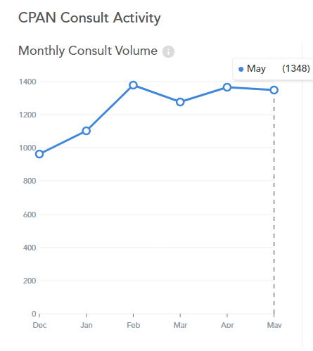
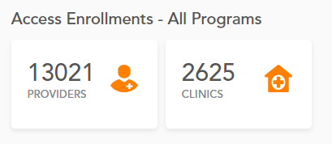
May 2024 Consultation Volume
2023 vs 2024
May 2023: 1317
May 2024: 1348
Notes:
Percent of the increase : 30% increase

Slide 4
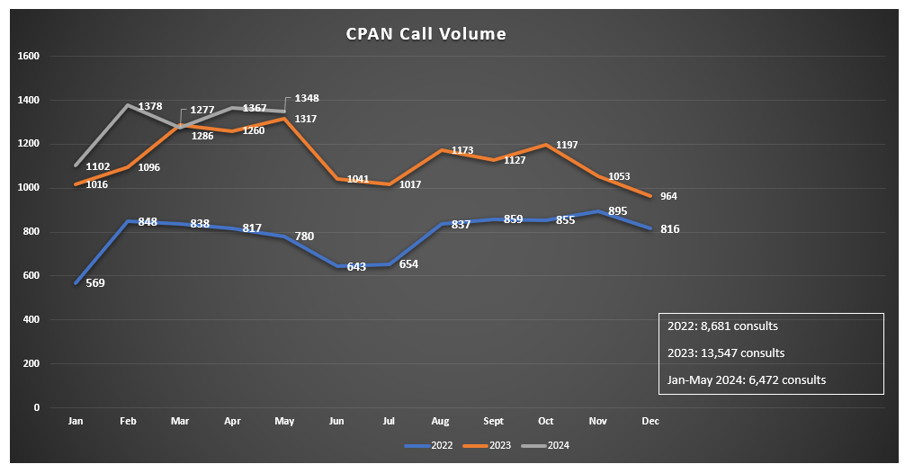

Slide 5
Perinatal Psychiatry Access Network (PeriPAN)
Sarah Mallard Wakefield, MD
Medical Director of PeriPAN
Associate Professor and Chair of Psychiatry
School of Medicine, TTUHSC

Slide 6
PeriPAN Enrollment - 899 OBs - 164 OB clinics - 44 Women’s or Maternal Health clinics - 13 Midwifery practices

Slide 7
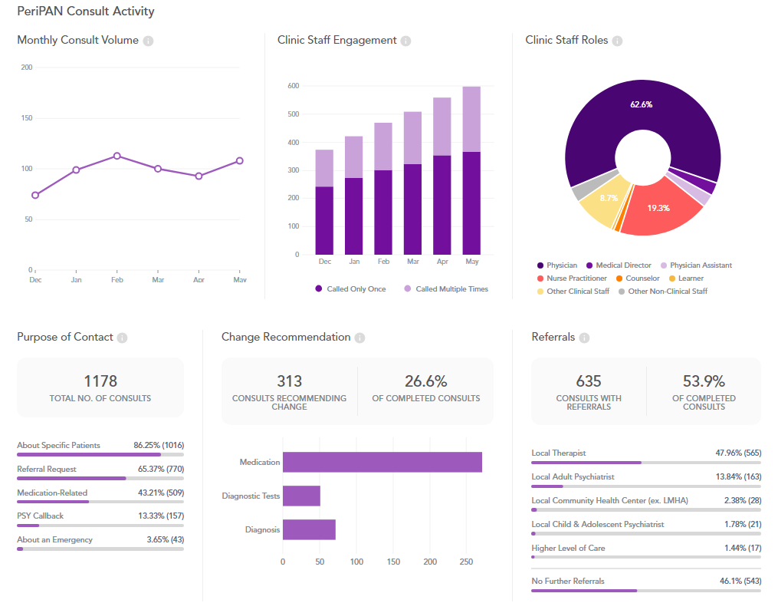
PeriPAN Activity
May 2024

Slide 8
Consult Activity: Physician 66% of calls

Slide 9
April - May 2024 PeriPAN Consultations
* this data is preliminary and is subject to change​

Slide 10
Date & Time | Topic
1/16/2024 | Introduction to Perinatal Mood and Anxiety Disorders
2/20/2024 | Screening and Diagnosis of Bipolar and Schizophrenia Spectrum in the Pregnancy and Postpartum Period
3/19/2024 | Screening and Diagnosis of Anxiety and Depression in Pregnancy and the Postpartum Period
4/16/2024 | Suicide Risk and Safety Assessment in Perinatal Mental Health
5/21/2024 | Psychotropic Medication in Breastfeeding and Pregnancy
6/18/2024 | Psychopharmacology and Perinatal Mood and Anxiety Disorders
7/16/2024 | Substance Use in the Perinatal and Postpartum Periods
8/20/2024 | Eating Disorders and Perinatal Mental Health
9/17/2024 | Perinatal and Postpartum Psychosis
10/15/2024 | NICU Parent Supports and Considerations
11/19/2024 | Paternal Mental Health and the Perinatal-Postpartum Periods
PeriPAN Grand Rounds Schedule
2024
3rd Tuesday of the month
12:00-1:00 CT

Slide 11
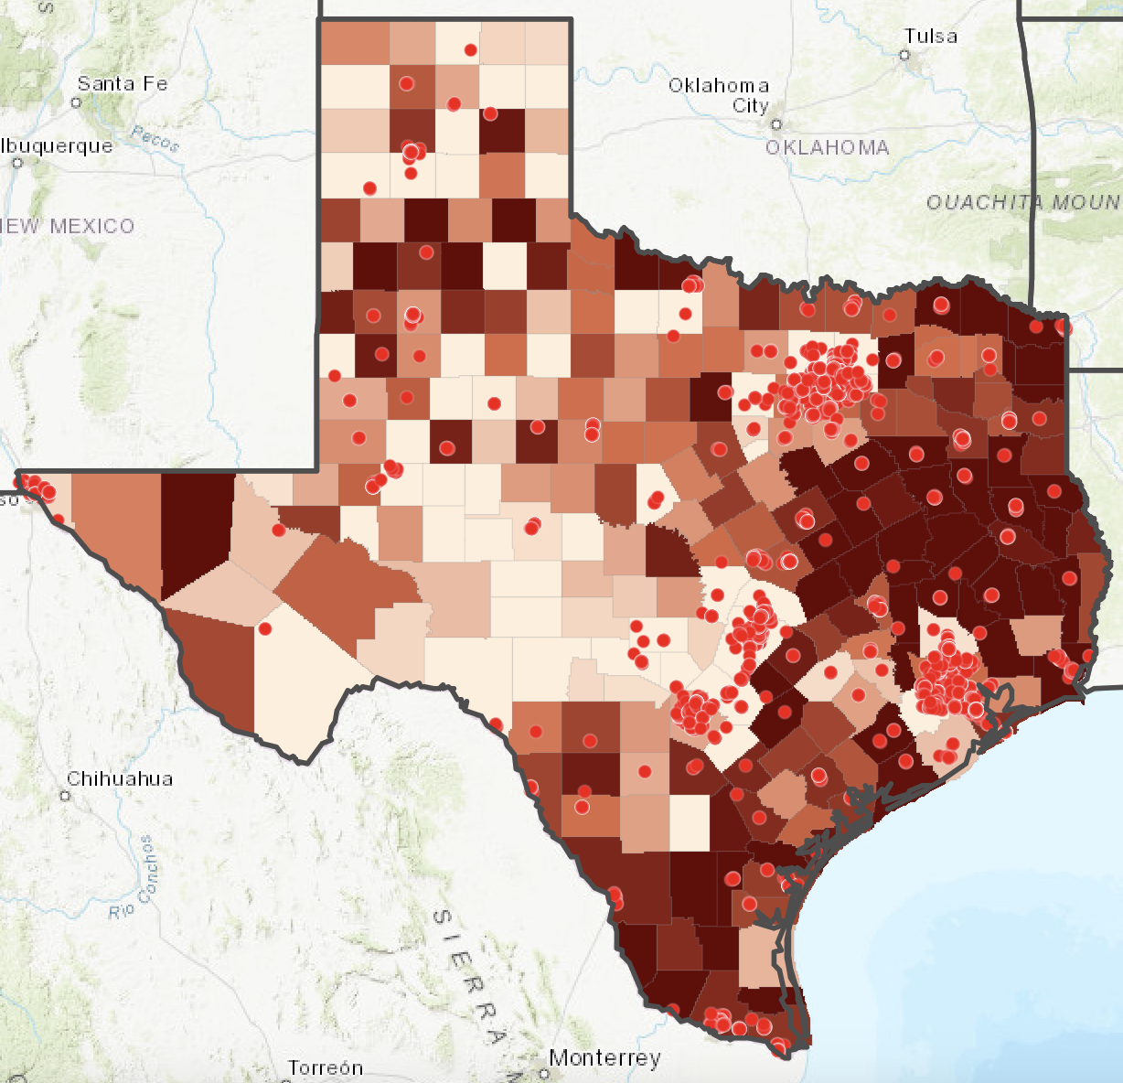
PeriPAN Collaboration Updates
ACOG and PeriPAN
Pathways to Perinatal Mental Health Equity (Pathways)
Postpartum Depression ECHO Launch
PeriPAN Toolkit Webinar available
Scan QR code to access
District XI Annual District Meeting: Council meeting with residents
Geographic & practice selection
OB practice recruitment
Collaborating with TexasAIM and TCHMB
ECHO series will run 6/11/24 -10/8/24
Registration: https://www.surveymonkey.com/r/N8DNY2C

Slide 12
PeriPAN/TPS ECHO Schedule
Summer/Fall
2024
2nd and 4th Tuesday of the month
12:00-1:00 CT
Date & Time | Topic
6/11/2024 | Introduction to ECHO
6/25/2024 | Introduction to Postpartum Depression Screening
7/9/2024 | Screening Tools and Assessment
7/23/2024 | Implementation strategies in Pediatric Practice
8/13/2024 | Communication and Support for Families
8/27/2024 | Collaborative Care and Referral Networks- Provider-facing and mother-facing
9/10/2024 | Billing, Coding, and Reimbursement for PPD Screening Services/ Advocacy and Policy
9/24/2024 | Non-maternal caregivers and depression
10/8/2024 | Maternal Well-Being

Slide 13
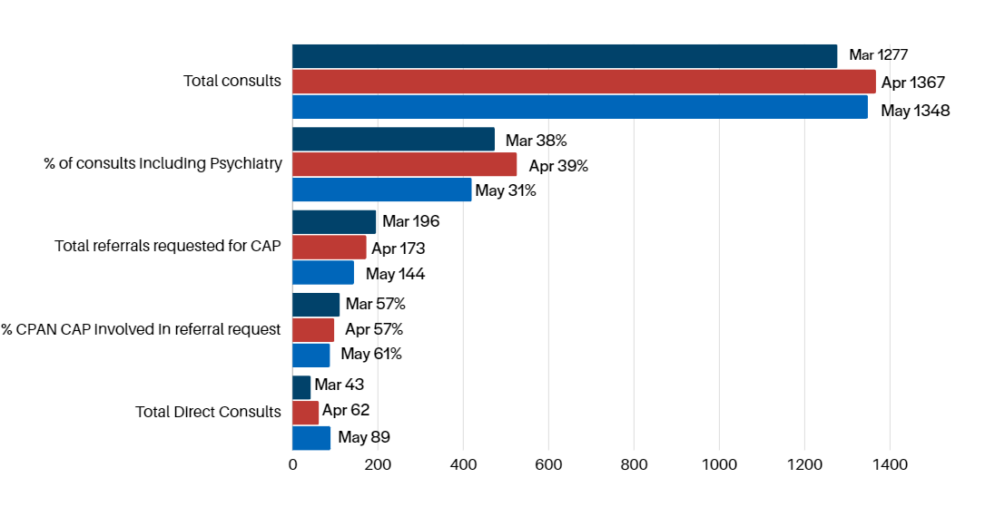
March- May 2024 CPAN Consultations
* this data is preliminary and is subject to change​

Slide 14
Trayt Engagement

Slide 16
TCHATT Referrals as of 5/30/2024
Total Students Referred to the Program – 70,177
* this data is preliminary and is subject to change​
Notes:
64176+6001

Slide 17
Referrals, Enrolled, and Served 23-24 School Year as of 5/30/2024
Notes:
Note: The Served with at Least 1 Encounter group includes those who receive at least one non-care coordination session; they are only counted in the first month in which they are served. It does not represent the number of unique students served each month (following graph).

Slide 18
Number of Treatment Sessions and Clients Served by Month as of 5/30/2024

Slide 19
Percent of Sessions by Participating Providers September 1, 2021 – May 30, 2024
Note: More than one provider may participate in a session.
Notes:
This version includes care coordination sessions.

Slide 20
Projects In Process
Developing training and process materials on approved policies for TCHATT 2.0
Working with UTS to develop policies to assist HRIs in implementing TCHATT 2.0
On site support and consulting with teams to address challenges and provide support in implementing efficient processes and organizational structure
Working with HRIs to prepare for implementation of TCHATT 2.0
Coordinating meetings with HRIs and ESCs to help facilitate strong partnerships and follow up with schools who may have been unresponsive or declined services
Working with UTS to support sessions at the upcoming TCHATT Summit

Slide 21
Trayt Roadmap - TCHATT
Feature | Phase | Estimate Release Date
Referral Dashboard | In Development | June/July
Family Experience Surveys | Finalizing Requirements | August
School Insights Dashboard | In Design | August
Tracking for Home School Enrollment | Finalizing Requirements | Aug

