Slide 1
Texas Child Mental Health Care Consortium
May 2024
Melanie Susswein, MSW

Slide 2
1
Partnerships
2
Branding
3
Social Media
4
Anniversary
Agenda
5
TCHATT

Slide 3
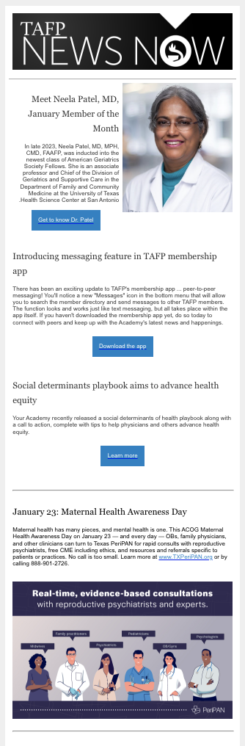
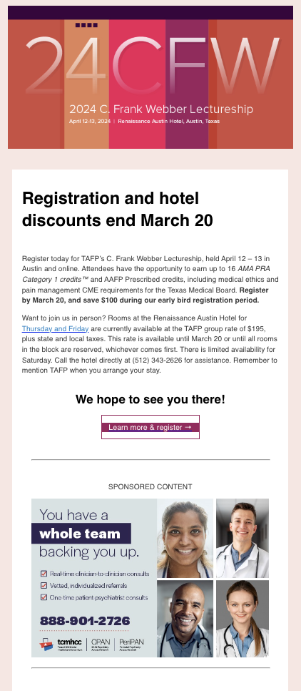
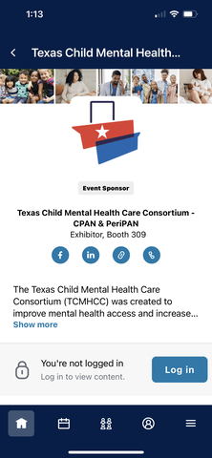

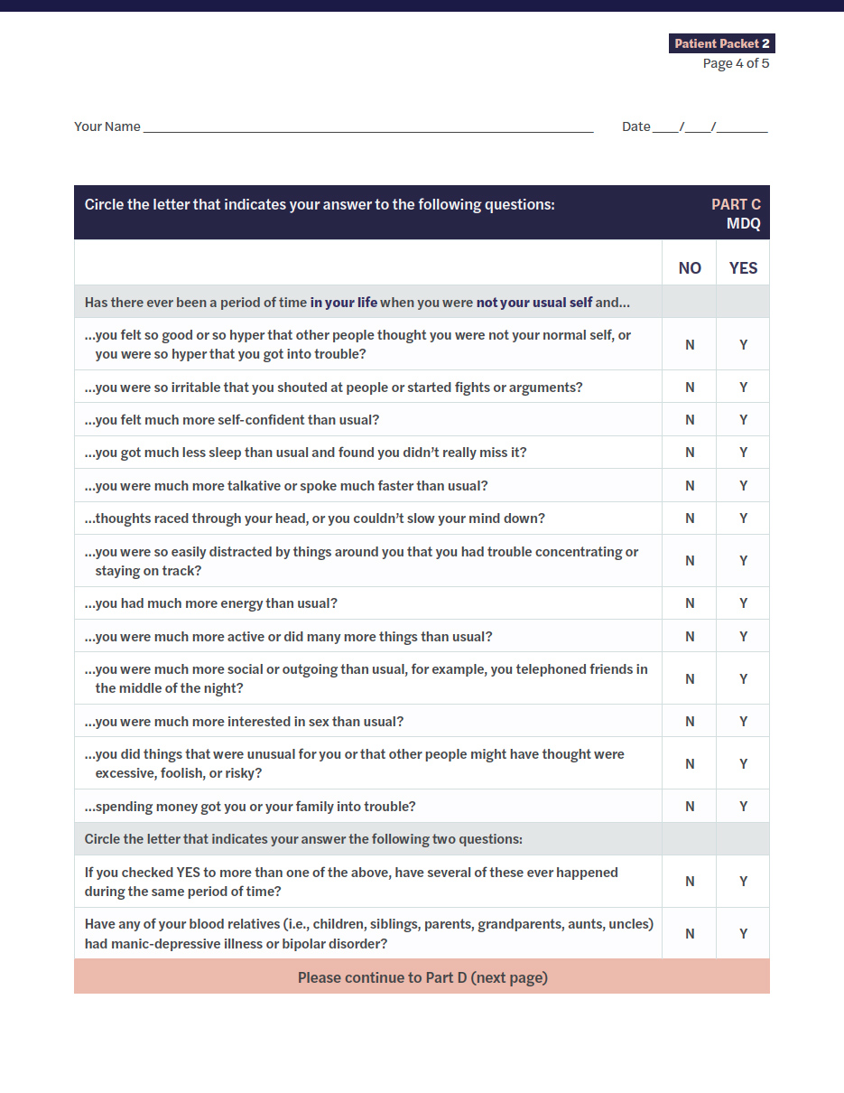
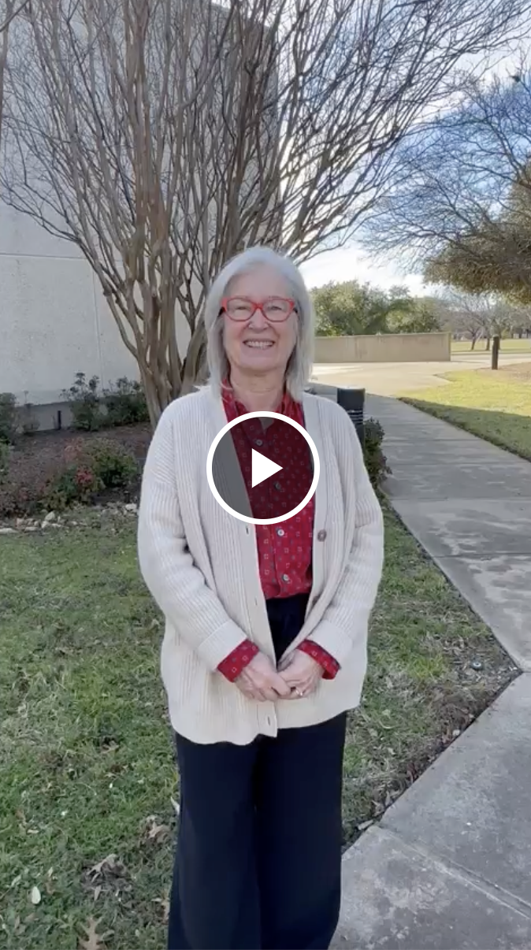
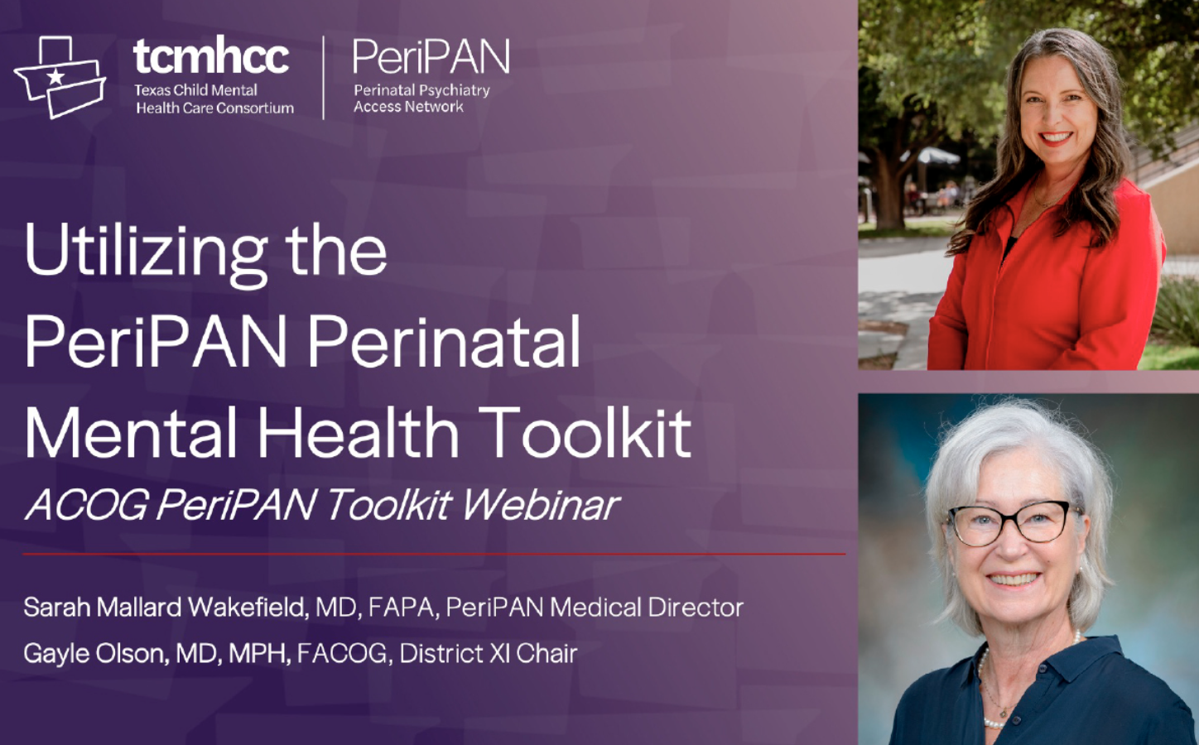
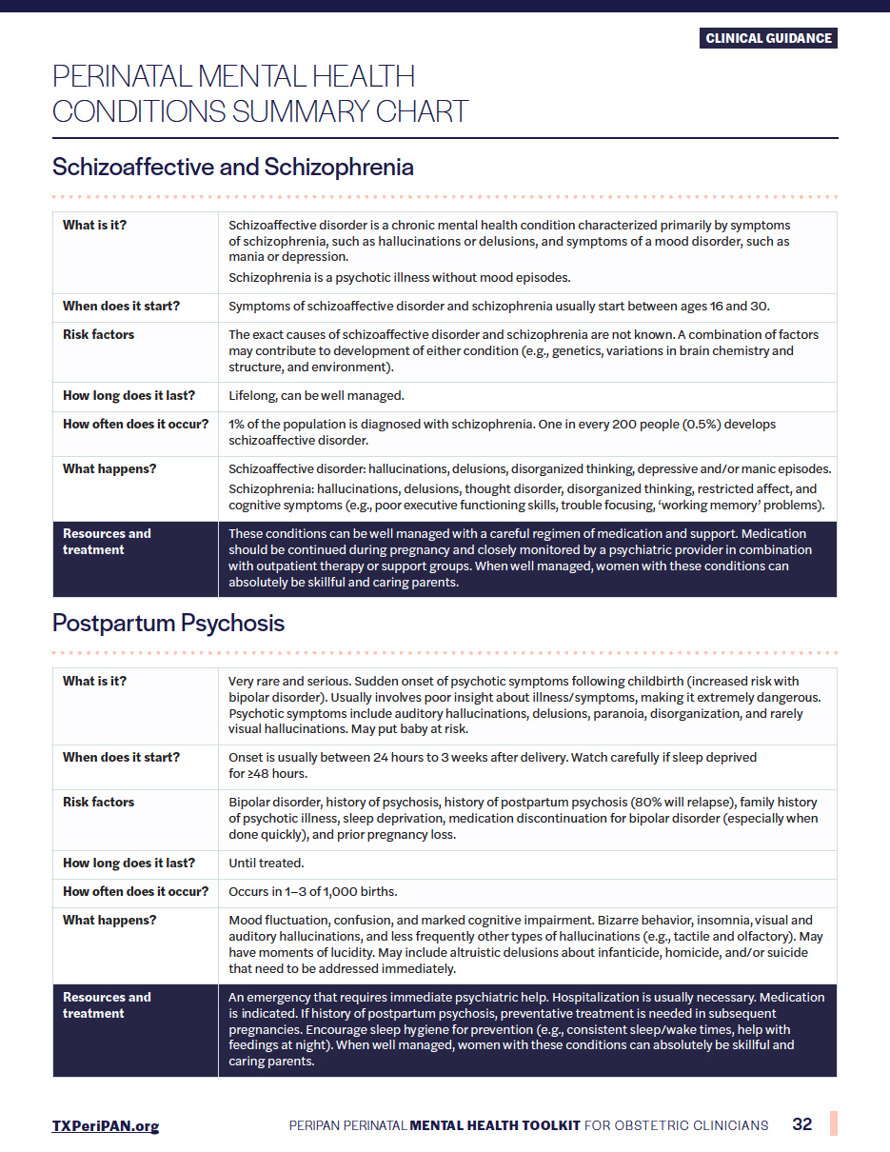



Power of Partnerships
Texas Pediatric Society
Dedicated monthly newsletters
Texas Academy of Family Physicians
Conference exhibits (table & app), spotlight ads, & presentations
(Nov 2023, April 2024)
Newsletter highlights & social media sharing
American College of Obstetricians and Gynecologists, District XI
Joint webinar for OB toolkit release
MH Awareness Month video clip
With all: anniversary coordination

Slide 4
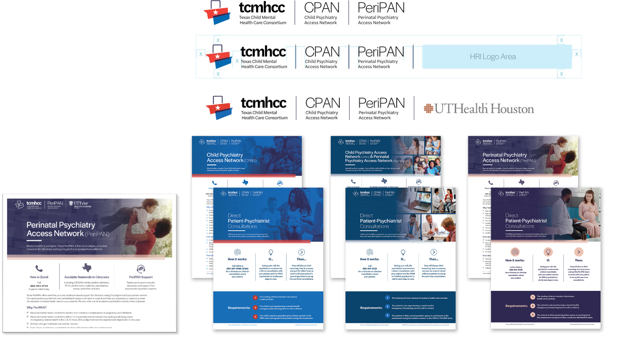
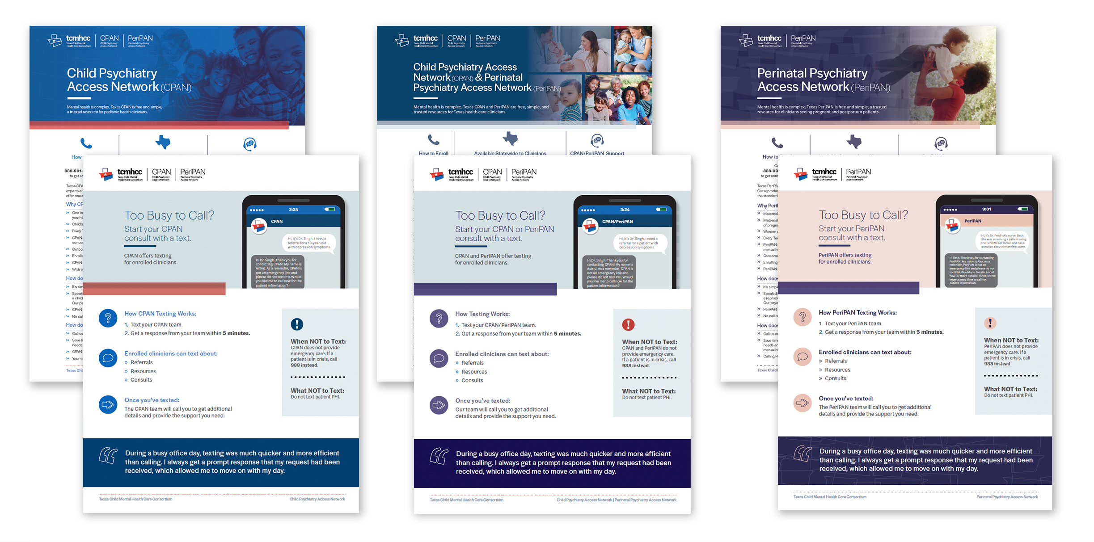
Rebranding Material
Development
Created versions for CPAN (historical), PeriPAN, and CPAN+PeriPAN (>200 files).
Created HRI-specific versions
Updated brand guidelines and applied to content
Notes:
Melanie will speak to the following:
1. As Lainie previously mentioned we updated our brand to include PeriPAN- that meant creating a look and feel for stand alone PeriPAN materials so they would quickly catch the eyes of OB clinicians and also integrating PeriPAN as an extension of CPAN into all of those previously designed materials. This resulted in the content review, update, and creation of over 150 documents. We are focused on providing materials at a state level and also, when appropriate, individualized for each HRI. We envision that the PeriPAN only materials are used only for the OB audience. The CPAN+ PeriPAN used for all other clinicians because we want pediatric clinicians and family medicine clinicians to know that PeriPAN is also a resource for them. We do not anticipate using the CPAN only version of documents any longer.
Chris- I think visual can be a collage of sorts of the brand guidance documents when I speak of the brand guidance and then a collage or sorts showing PeriPAN only and then combined documents. And then off to the side a lone CPAN document.

Slide 5
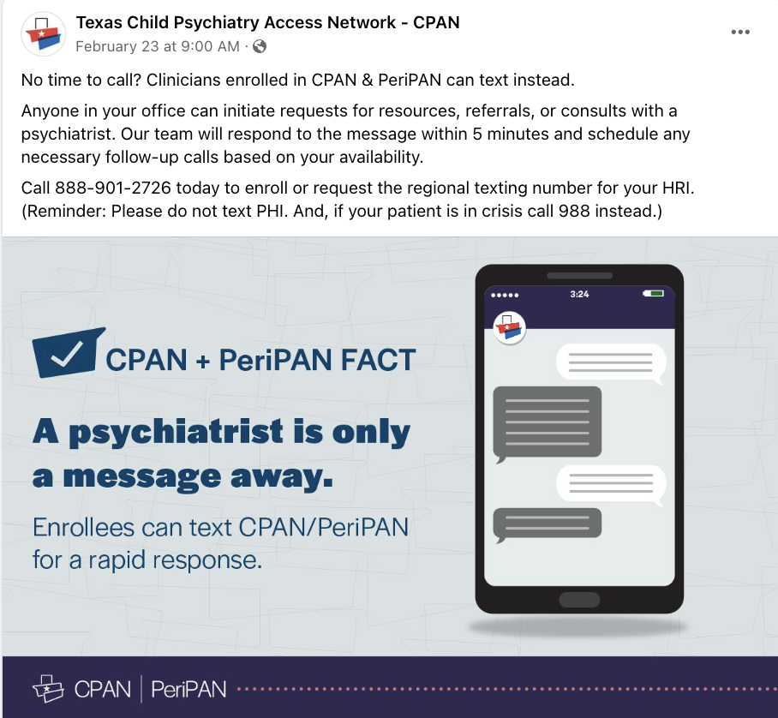
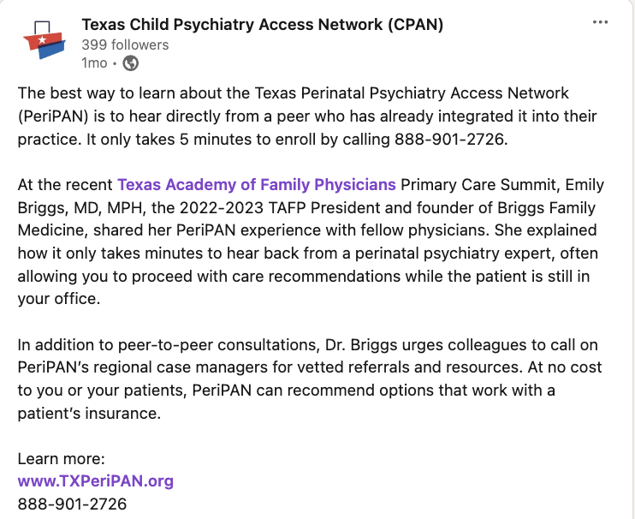
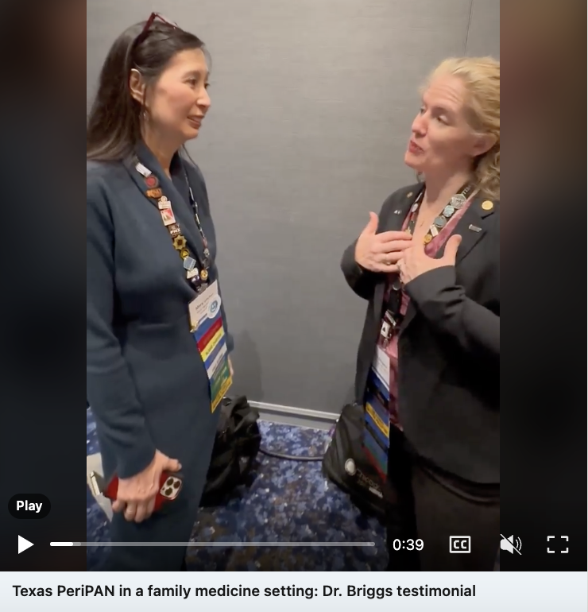
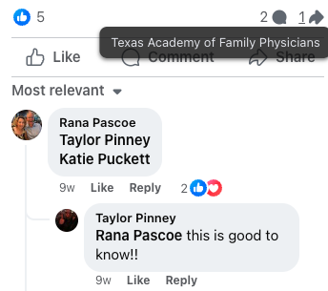


Social Media Analysis
March 2023–April 2024
IMPACT
LinkedIn
167 posts
22,553
people reached
Facebook
175 posts
19,808
people reached
AUDIENCE
GROWTH
LinkedIn
+143%
From 183 to
445 followers
Facebook
+29%
From 517 to
669 followers
Facebook post about texting option shared by TAFP
→ interaction between
3 pediatric NPs in Rockwall
Top LinkedIn Post
TAFP President Dr. Briggs’ testimonial video
(12/20/23) → 750 people reached

Slide 6
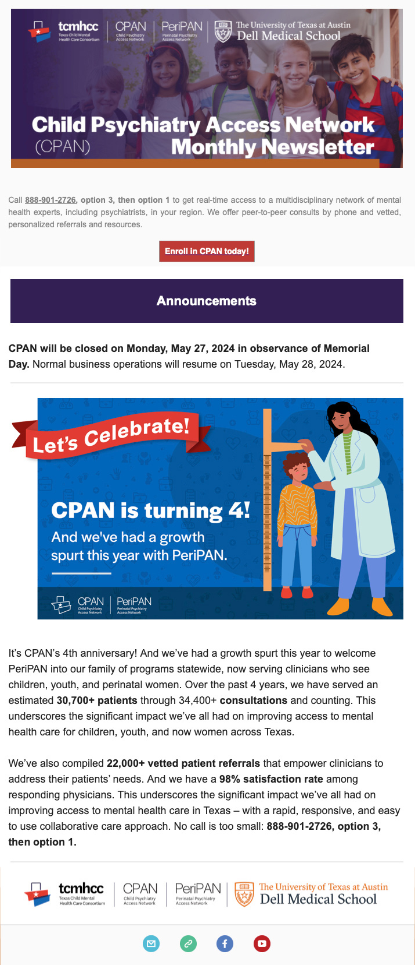

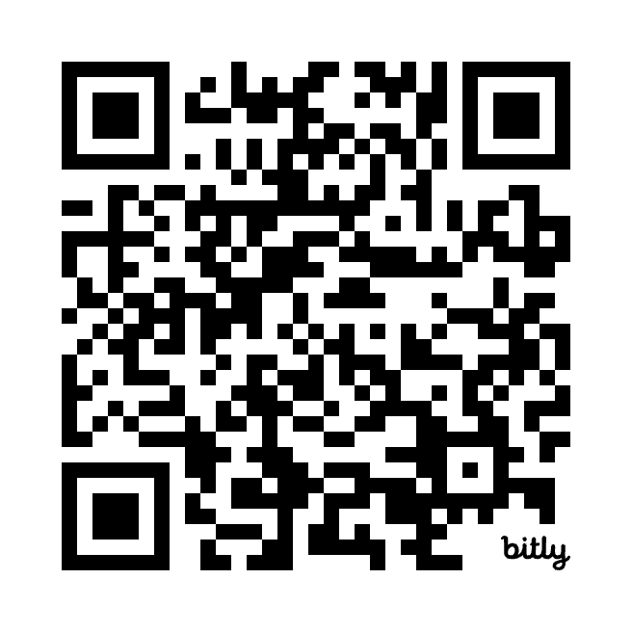
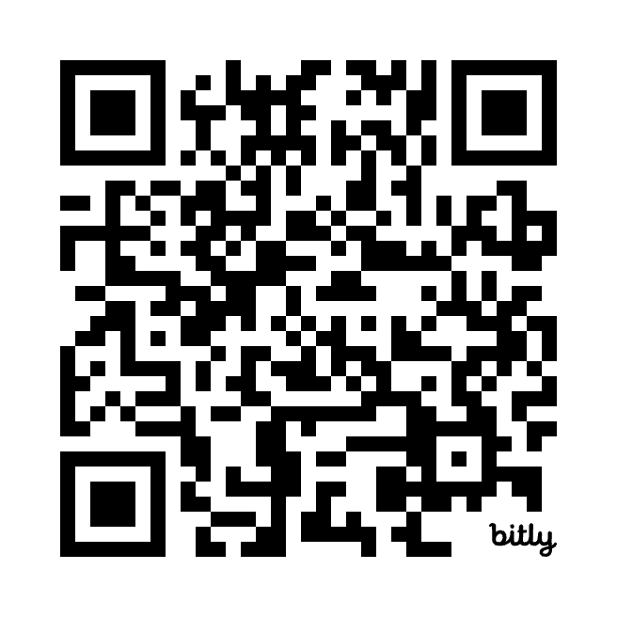
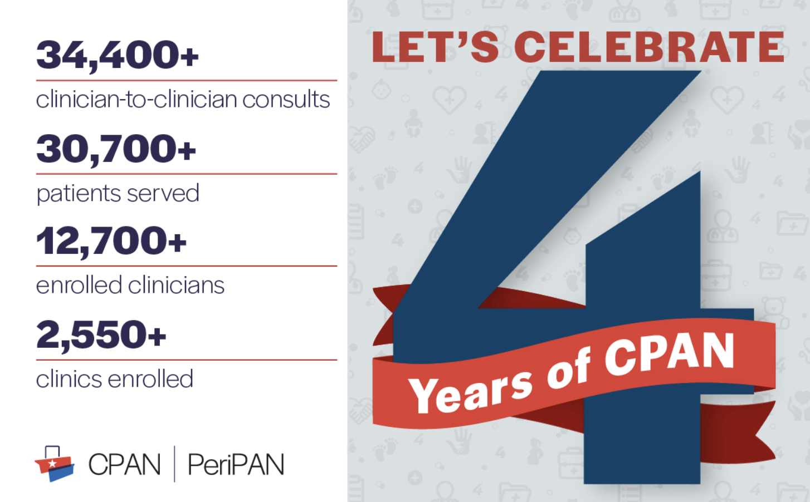
4th Anniversary
Please visit our accounts and help us promote CPAN 4th Anniversary posts today!
Facebook
bit.ly/CPAN_FB
LinkedIn
bit.ly/CPAN_LI

Slide 7
TCHATT
Materials
Audit
HRI
Interviews
Counselor Interviews
Parent Interviews
What's Next?
Document library
Document analysis with PhD students
Health communication best practices topline report
Formative research
Individual meeting with each HRI
Findings in a topline report, including identified needs for content library and materials
Interviews with 13 counselors
Corroborated and built upon HRI data on material needs
Interviews in process with
~24 parents or guardians
Line of questioning related to communications
Development of materials
Flexibility and consistency
Corroborated data

Slide 8
Q & A

