Slide 1
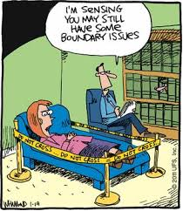
Centralized Operation Support Hub -COSH Updates
Dr. Laurel Williams
Edith Ortiz
Jenn Cole

Slide 3
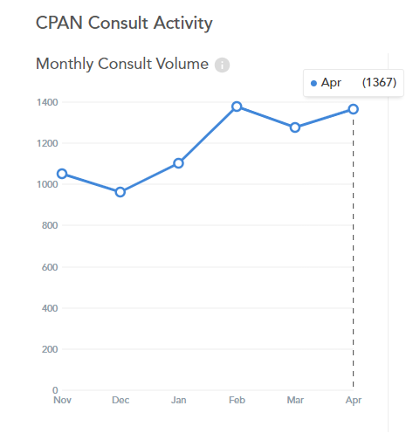
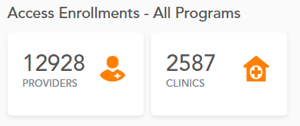
April 2024 Consultation Volume
2023 vs 2024
April 2023: 1260
April 2024: 1367
Notes:
Percent of the increase : 30% increase

Slide 4
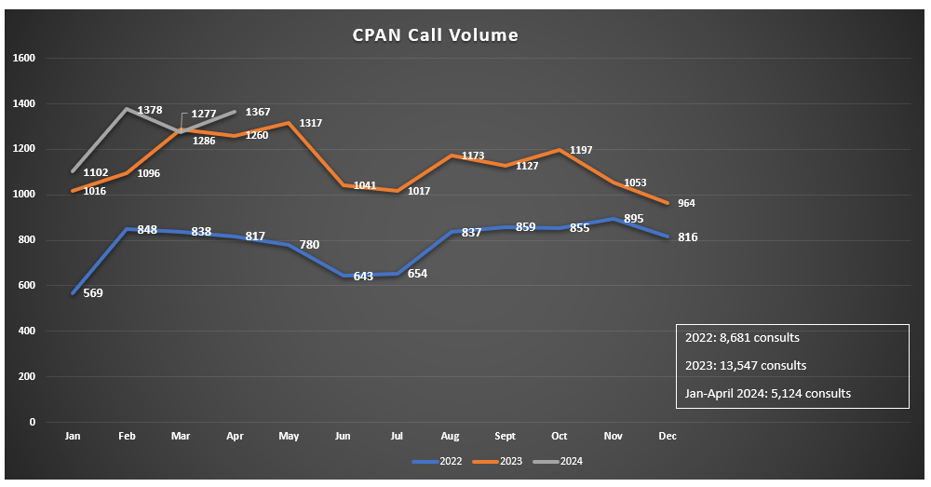

Slide 5
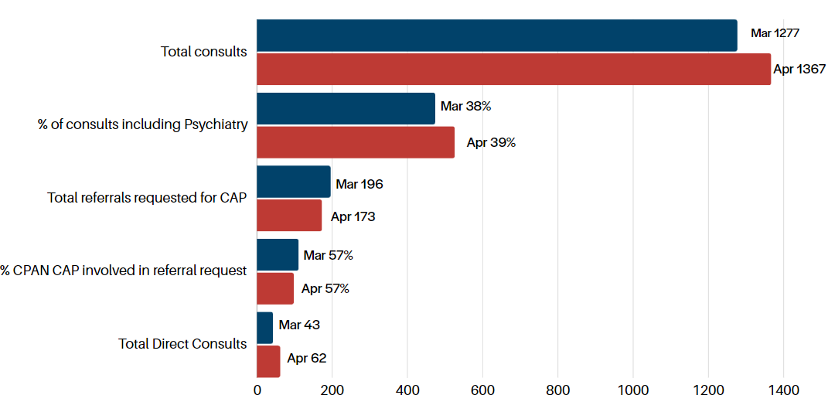
March- April 2024 CPAN Consultations
* this data is preliminary and is subject to change​

Slide 6
QI Project Update: Increase contact with providers enrolled and never utilized CPAN
COSH CPAN/PeriPAN Psychiatrist meeting
Review outreach data
Address questions
Offered additional support if needed
April Data
568 outreach calls have been made
7 resulted in CPAN consults
20 resulted in CPAN education
3 resulted in a CPAN ethics presentation request

Slide 7
COSH Workgroups
Educational Resource Workgroup
Topic : Anxiety
Anxiety Disorder
Separation Anxiety Disorder
Social Anxiety
Selective Mutism
School Avoidance
Specific Phobias
Panic Disorder (attacks)
Obsessive-compulsive disorder
Currently: Workgroup meeting with experts
Next topic : Depression

Slide 8
COSH Workgroups
CME standardization workgroup
Workgroup will: consist of 6-7 psychiatrists
Workgroup tasks: Review and create content
Once slides have been completed all CPAN psychiatrist will review and sign off on content

Slide 9
Trayt Roadmap
Feature | Phase | Estimate Release Date
Direct Patient Consultation Process | In Development | Q2-Q3 2024
PCP Caller (Calling on behalf of the doctor) | Design | TBD
PCP Web Portal | Design | TBD
Add unique physician identifier (NPI) | Defining Requirements | TBD
PCP experience/engagement surveys | Defining Requirements | TBD

Slide 11
TCHATT Referrals​
Total Students Referred to the Program – 62,255
* this data is preliminary and is subject to change​

Slide 12
Referrals, Enrolled, and Served 23-24 School Year

Slide 13
Number of Treatment Sessions and Clients Served as of 4/30/2024

Slide 14
Percent of Sessions by Provider Type September 1, 2021 - April 30, 2024
Note: More than one provider may participate in a session.

Slide 15
Number of Sessions by Provider Type and Fiscal Year September 1, 2021 - April 30, 2024
Note: More than one provider may participate in a session.

Slide 16
Percent of Sessions by Provider Type and Fiscal Year September 1, 2021 - April 30, 2024
Note: More than one provider may participate in a session.

Slide 17
Assessment Completion by HRI

Slide 18
Projects In Process
Working with UTS to develop policies to assist HRIs in implementing TCHATT 2.0
Working with CHC on counselor interviews, parent interviews and working with HRIs to create TCHATT 2.0 materials
On Site support and consulting with teams to address challenges and provide support in implementing efficient processes and organizational structure
Working with HRIs to prepare for implementation of TCHATT 2.0
Coordinating meetings HRIs and ESCs to help facilitate strong partnerships and follow up with schools who may have been unresponsive or declined services
Working with UTS to support sessions at the upcoming TCHATT Summit

Slide 19
Assessment Workgroup
Any students that screen with positive scores on an assessment, that assessments would be repeated every 4 weeks. If assessments are negative, they will not continue to get them. The exceptions will be the CRAFFT. Rescreening of the CRAFFT will be determined by clinician.
10 & under:
SCARED (Parent required, Child Optional)
SNAP (Parent)
CIS (Parent)
11 & up:
PHQ-9a, (Child) - Day of visit
Columbia Suicide Screener (Child) Day of Visit
GAD 7 (Child) Sent before
CRAFFT 2.0 (Child) Sent before
CIS (Parent/Child) Sent before
SNAP – (Parent) Sent before

Slide 20
Trayt Roadmap - TCHATT
Feature | Phase | Estimate Release Date
Referral Dashboard | In Development | July 2024
Family Experience Surveys | In Design | TBD
School Insights Dashboard | In Design | TBD
Referral Source Tracking | In Design | TBD

