Slide 1
Brief description of the model:
The overall goal is to meet the needs of youth who are homebound and school avoidant by virtue of anxiety/agoraphobia or other psychiatric concerns (as opposed to conduct-problem-related truancy). We implemented this project anticipating an uptick in school avoidance among vulnerable youth, incubated by pandemic school closures. Effective behavioral treatment usually involves more intense and frequent contact and school liaison, than staffing patterns predicated on typical weekly or biweekly psychotherapy permit.
Timeline to Standup:
2 to 3 months devoted to training in overall treatment
model and establishing the intake/assessment data
systems. Then began taking referrals.
Goal Metrics: FY22/23: 210 sessions/35 unique youth
Goal metric completion date: 5/21/23
ANXIETY/
SCHOOL AVOIDANCE

Slide 2
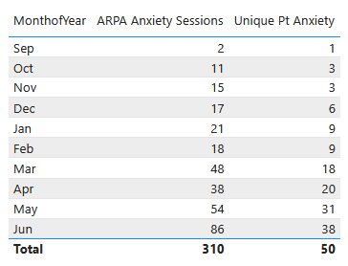
Impact so far…
Average number of sessions per child: 6
Typical duration of care: 10 to 12 Sessions
Total Referrals: 59 to date
Unique Patients Enrolled: 50
Unique Sessions Provided: 310
Currently Active Patients: 40
Lost to Follow Up and Drop Out: 1
Successfully Completed Treatment: 2
Currently monitoring students throughout the summer to assess progress with reintegration into the new school year on the path to successful discharge.

Slide 3
Parent Feedback
-"Thank you so much, I didn't think your techniques or suggestions would work but they did! My son is doing so much better because of his therapy."
-"Thank you so much for all you have done to help us. My daughter is now going to school with no problem!"

Slide 4
Hurdles and Challenges
Parent engagement and participation
Coordination with school counselor to liaison
Limits of in vivo exposures
Scheduling with families (desired frequency of sessions 1 to 2x per week + check-ins)
Commitment for client to return to in-person schooling
Delay in referral stream gaining momentum
Initial assessment data has been complicated or time consuming on occasion
Occasionally, homebound school-avoidance develops among youngsters with more severe psychiatric issues. There are very few suitable day-treatment programs for these students. The few that do exist lack a school program.
Point of Contact: Dr. Joseph Blader, Ph.D. blader@uthscsa.edu

