Slide 5
Evidence-based, cognitive behavioral youth- and family-centered intervention for suicide and self-harm
Adapted from emergency rooms into primary care visits
Goals:
Reduce risk
Ensure safety
Assist with linkage to care in the community
Adequate safety planning in session is preferred to immediate referral to ER

Slide 6
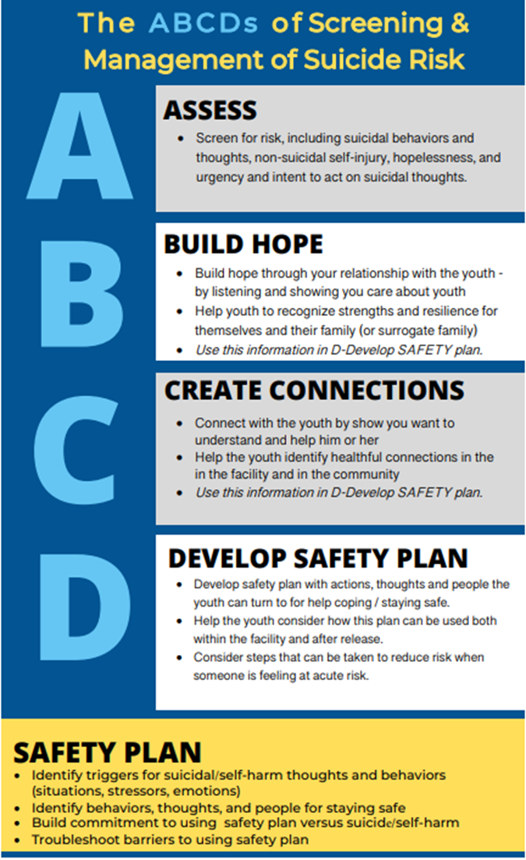
SAFETY-A Youth Session
Assessment of suicidality
Identify youth strengths
Identify strengths in family and environment
Understand emotional reactions associated with suicide risk
Develop personal safety plan
Counseling on means restriction and disinhibiting effects of substances

Slide 7
SAFETY-A Family Session
Identify youth and family strengths
Strategies for ensuring safe settings
Psychoeducation on suicide warning signs
Taking suicidal talk/behavior seriously
Lethal means restriction
Protective monitoring
Disinhibiting effects of substance use
Supporting youth in safety plan use
Review emergency protocol

Slide 8
ARPA Implementation
Feasibility and acceptability of SAFETY-A training and implementation
Collaboration across 7 sites to achieve goal of 50 PCPs trained on SAFETY-A
BCM: lead hub
UT-SW: data
Texas A&M: recruitment
UTMB: recruitment
UT-Houston: recruitment
Texas Tech: recruitment
UT-Austin Dell: recruitment

Slide 9
SAFETY-A Progress
19 PCPs trained in first training cohort (last month)
46 total in attendance
12 staff undergoing training as trainers
Upcoming trainings on 3/29 and 4/17

Slide 10
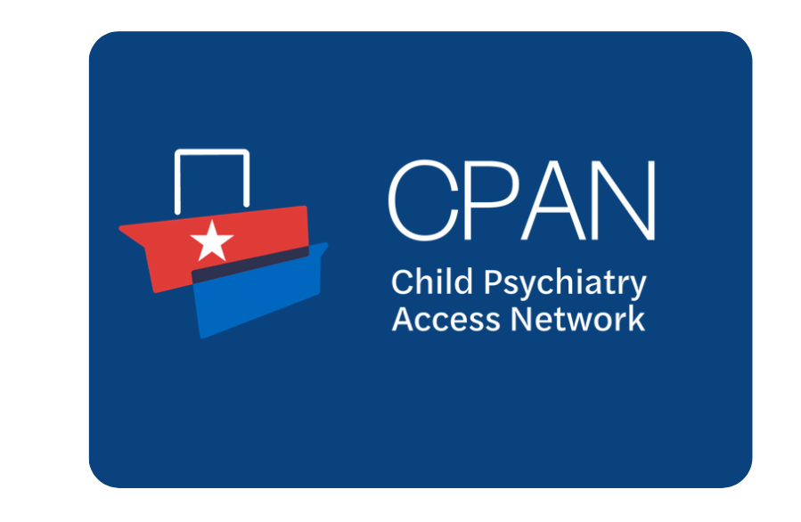

Slide 12
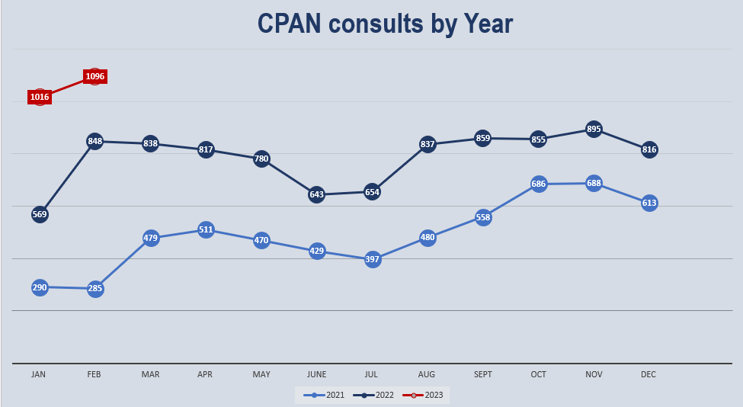

Slide 15
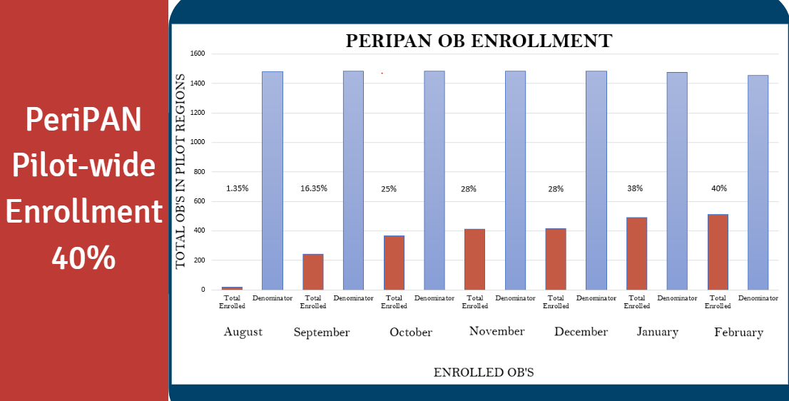

Slide 16
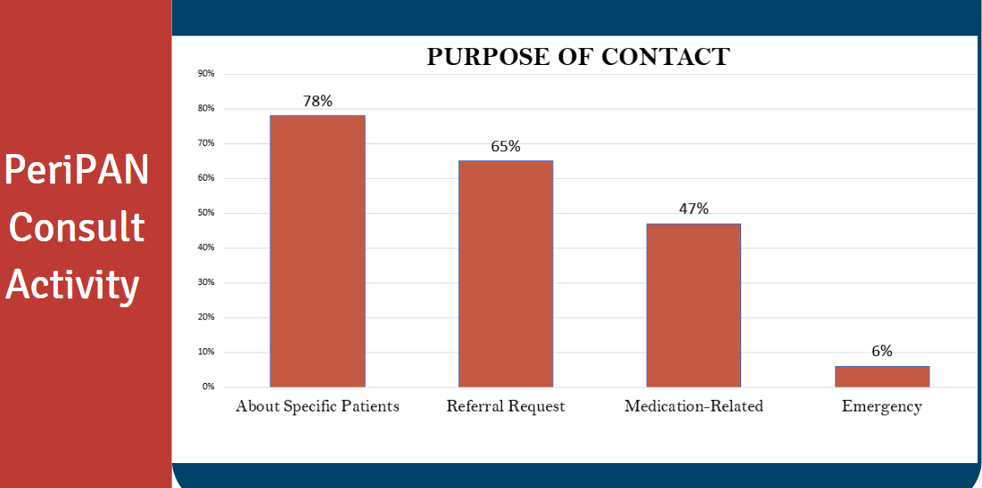

Slide 17
