Slide 1
Centralized Operation
Support Hub (COSH)
May 2023
Dr. Laurel Williams Dr. Sarah Wakefield
Edith Ortiz Jenn Erdige
Jenn Cole

Slide 2
COSH Updates
CPAN
PeriPAN
TCHATT
Topics for
Discussion

Slide 3
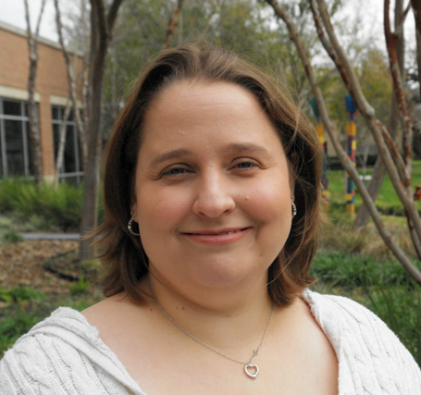
Started March 27
Over 15 years implementing school-based mental health programming
20 years of program development, implementation and expansion experience
Part of the leadership team that stood up the UT Houston TCHATT Program

Slide 5
Welnity Updates
Improvements for better user experience being worked on:
Streamlining search capabilities
Data input improvements
Phase: Defining requirements

Slide 6
Lantana Updates
Development Phase: Vetting new voice recording
Timeline: will be determined once vetting process is completed

Slide 7
Direct Consult
9 teams currently doing direct consults
142 number of direct consults have been completed
Direct Consult across the state
HRI coverage
BCM | Dell | Texas Tech El Paso | Texas A&M | UTSA | UT Tyler
UT Houston | UNT | Texas Tech Lubbock | UTMB | UTRGV | UTSW
*HRI coverage order could change

Slide 8
Completed Trayt Initiatives
Feature | Phase | Completed Release Date
PeriPAN Build Insights & Reporting Phase 1: Exports without perinatal characteristics | Completed | September 2022
PeriPAN Build Insights & Reporting Phase 2: Perinatal Characteristics Exports | Completed | November 2022
PeriPAN Build Insights & Reporting Phase 3: Insights Dashboard without perinatal characteristics | Completed | November 2022
PeriPAN Build Insights & Reporting Phase 4: perinatal characteristics insight dashboard | Completed | January 2023

Slide 9
Current Trayt Initiatives
Feature | Phase | Estimated Release Date
Medication Recommendation Improvements | Development | Q2 - 2023
Medication History Improvements (Behavioral Consult) | Development | Q2- 2023
Call Form Part 1 Improvements | Development | June 2023
Call Form Part 2 Improvements | Defining Requirements | TBD
Call Form Part 3 – Direct Consultation | Defining Requirements | TBD
Direct Consult PCP letter | Defining Requirements | TBD
PCP Web Portal | Focus Group | TBD

Slide 10
Trayt Dashboard

Slide 19
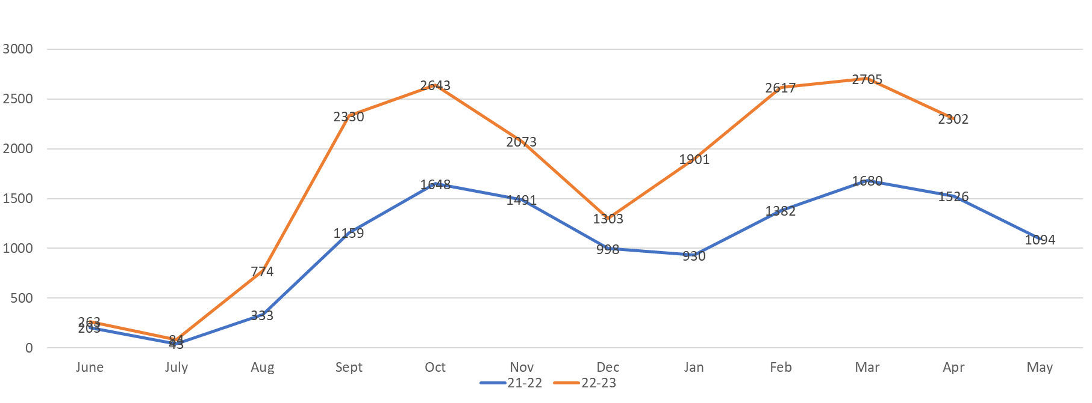

Slide 20
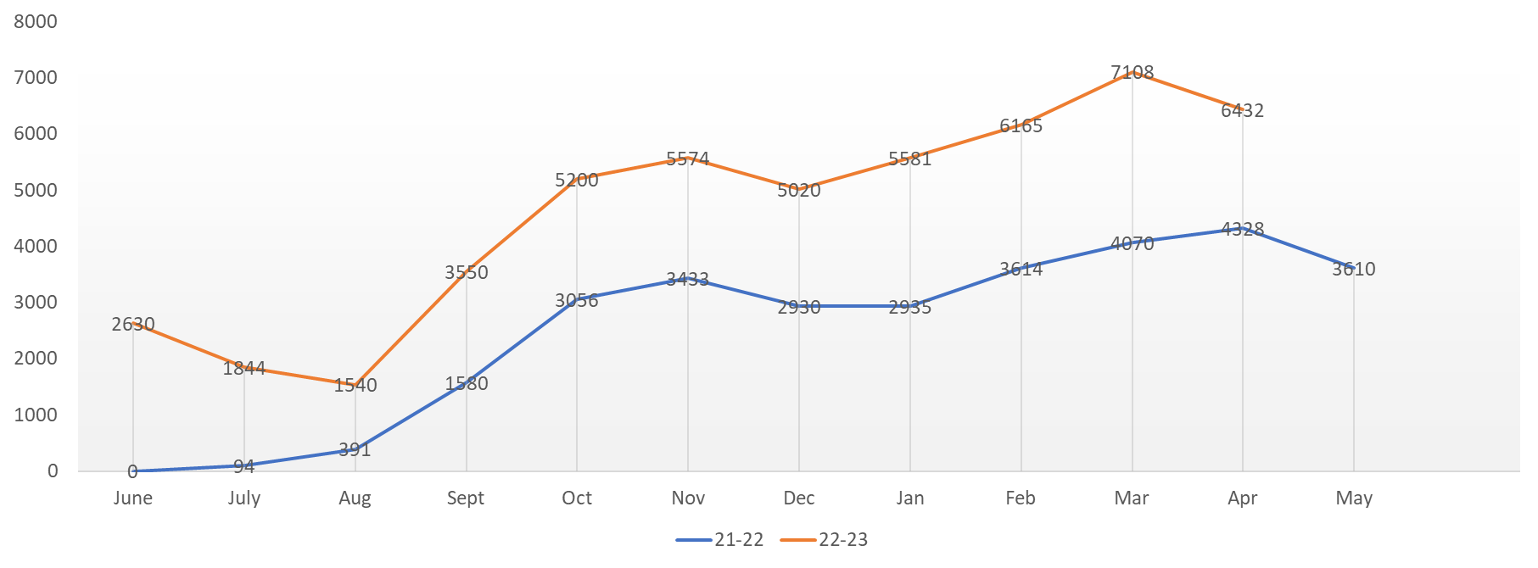

Slide 22
