Slide 1
Centralized Operation Support Hub -COSH Updates
Dr. Laurel Williams
Edith Ortiz
Jenn Cole

Slide 3
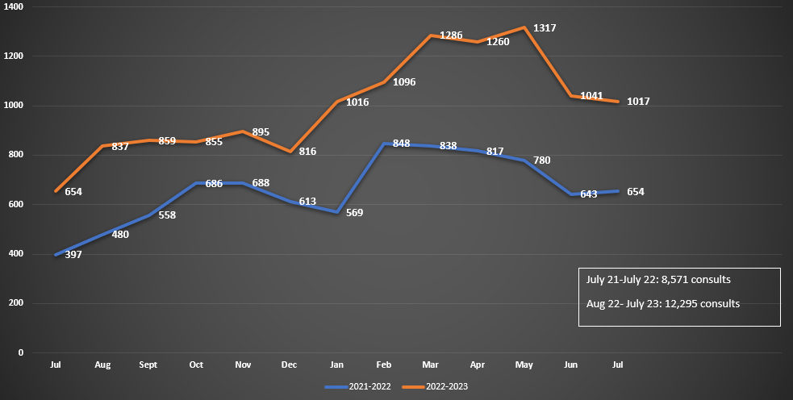
CPAN Call Volume
* this data is preliminary and is subject to change
Notes:
Percent of the increase : 30% increase

Slide 4
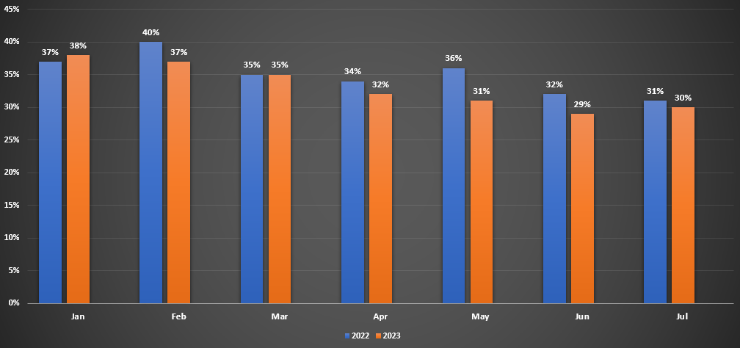
CPAN Psychiatry Consults
* this data is preliminary and is subject to change

Slide 5
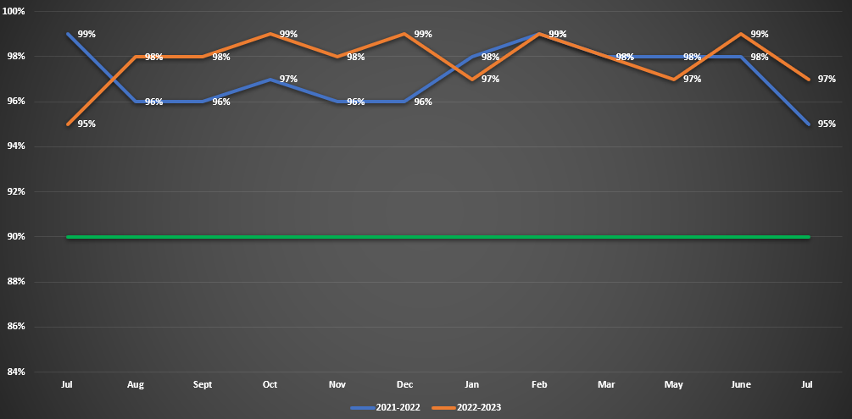
CPAN 30 Minute Metric
* this data is preliminary and is subject to change

Slide 6
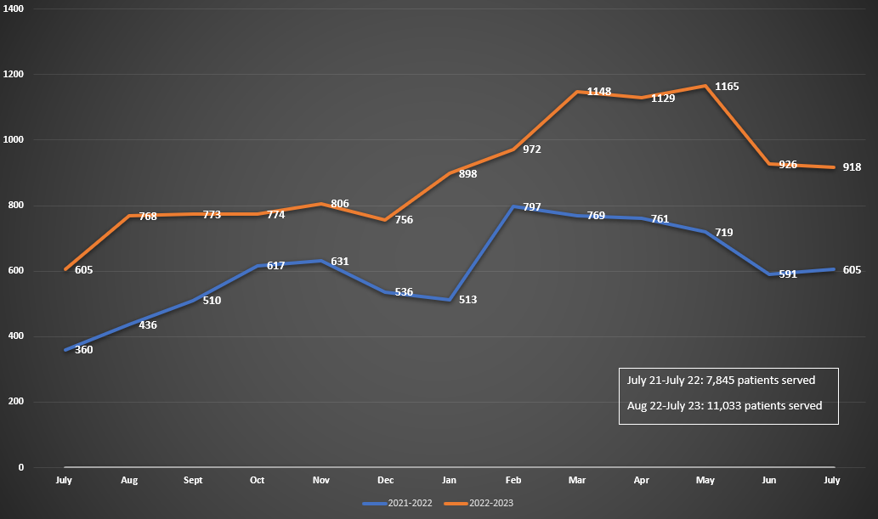
CPAN Patient Served
* this data is preliminary and is subject to change
Notes:
Percent of the increase : 29% increase

Slide 7
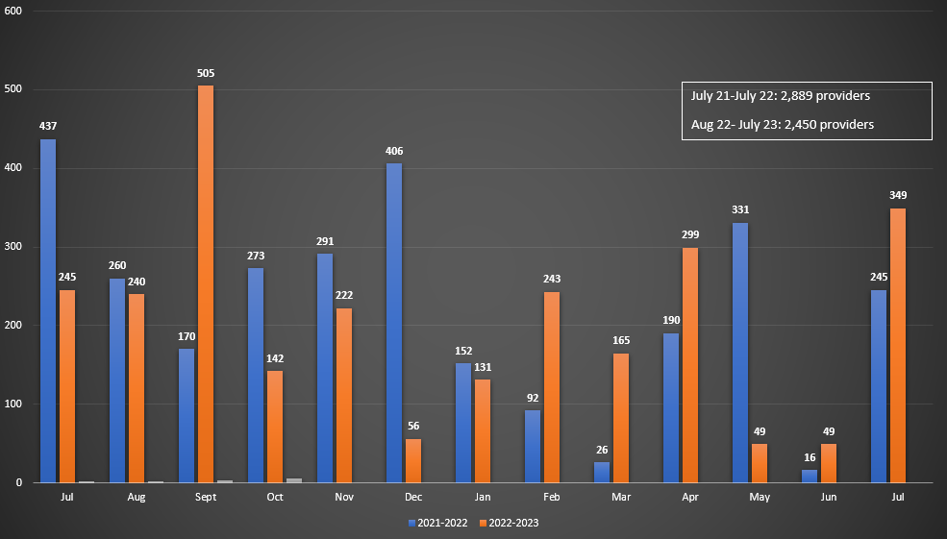
CPAN Provider Enrollment

Slide 8
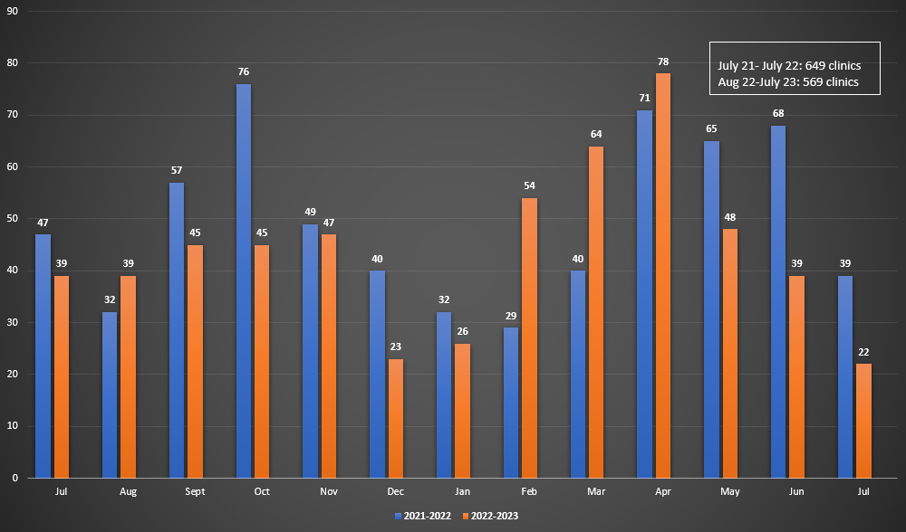
CPAN Clinic Enrollment
* this data is preliminary and is subject to change

Slide 9
CPAN Direct Consult
Total Direct Consult: 250 *data from 8 of 9 teams
9 teams doing direct consults
Teams are collaborating on direct consults
Currently developing the statewide direct consultation process
CPAN Texting
Total Text – 984 to date *data from 11 of 12 teams

Slide 11
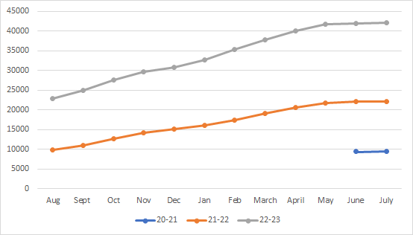
TCHATT Students Referred Since Program Start ​
Total Students Referred to the Program 41,200 ​
Students Served
24,542​
Sessions with Students
97,054
* this data is preliminary and is subject to change​

Slide 12
Current Trayt Initiatives ​
Feature​ | Phase ​
Medication Tracking ​ | Testing in Sandbox​
Automated CIS ​ | Final Design​
Crisis Messaging Pop Up​ | Defining Requirements​
RCADS-25 Assessment​ | Testing in Sandbox​
Email as MFA​ | Defining Requirements​

