Slide 1
YAM Project Updates,
Expanded Curriculum,
& the Wellness Ambassadors Program
Madhukar Trivedi, MD
Center for Depression Research and Clinical Care
UT Southwestern Medical Center

Slide 2
YAM Project Updates

Slide 3
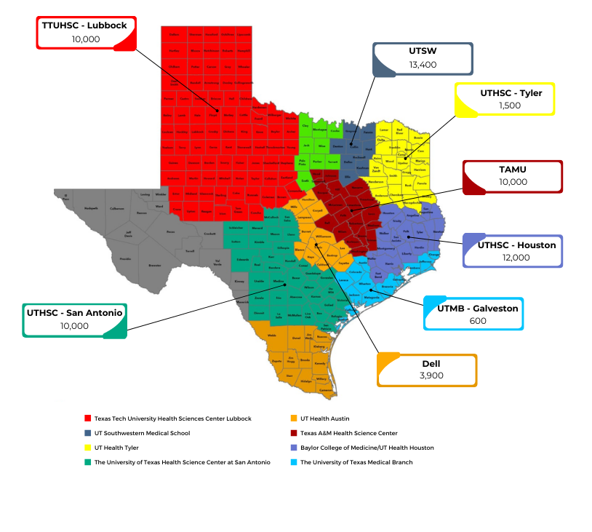
Youth Aware of Mental Health (YAM)
Evidence-based program delivered by certified facilitators to students in the classroom setting
A 5-hour interactive mental health promotion program
Delivered over 3 – 5 weeks
Encourages
increased discussion and knowledge about mental health
development of problem-solving skills
emotional intelligence and
resilience

Slide 4
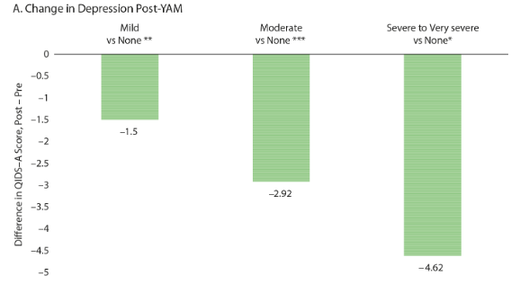
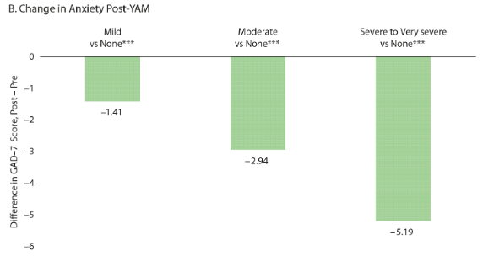
Results from YAM Thus Far
N=3,302 from UT Southwestern partnership schools (2017-2019)
26.5% had moderate to severe depression (PHQ-A ≥10)
22.3% had moderate to severe anxiety (GAD-7 ≥10)
Mayes et al., 2022

Slide 5
Selection of UTSW YAM Manuscripts
Published:
Hughes JL, Fuller A, Gutierrez L, South C, Trivedi MH. Feasibility and Acceptability of the Youth Aware of Mental Health (YAM) Program in Texas: Program Evaluation and Mental Health Outcomes. Poster. 9th Biennial Conference of the International Society for Affective Disorders; September 21-22, 2018.
Lindow JC, Hughes JL, South C, Gutierrez L, Bannister E, Trivedi MH, Byerly MJ. Feasibility and Acceptability of the Youth Aware of Mental Health (YAM) Intervention in US Adolescents. Arch Suicide Res. 2020;24(2):269-284. doi:10.1080/13811118.2019.1624667
Lindow JC, Hughes JL, South C, Minhajuddin A, Gutierrez L, Bannister E, Trivedi MH, Byerly MJ. The Youth Aware of Mental Health Intervention: Impact on Help Seeking, Mental Health Knowledge, and Stigma in U.S. Adolescents. J Adolesc Health. 2020;67(1):101-107. doi:10.1016/j.jadohealth.2020.01.006
Anderson JR, Hughes JL, Trivedi MH. School Personnel and Parents’ Concerns Related to COVID-19 Pandemic’s Impact Related to Schools. School Psychology Review. 2021;50(4):519-529. doi:10.1080/2372966x.2020.1862626
Anderson JR, Mayes TL, Fuller A, Hughes JL, Minhajuddin A, Trivedi MH. Experiencing bullying's impact on adolescent depression and anxiety: Mediating role of adolescent resilience. J Affect Disord. 2022;310:477-483. doi:10.1016/j.jad.2022.04.003
Trivedi MH, Nandy K, Mayes TL, Wang T, Forbes K, Anderson JR, Fuller A, Hughes JL. Youth Aware of Mental Health (YAM) Program With Texas Adolescents: Depression, Anxiety, and Substance Use Outcomes. J Clin Psychiatry. 2022;83(4)doi:10.4088/JCP.21m14221
Under Review:
Anderson, J. R., Nandy, K., Hughes, J. L., Kahalnik, F., Pipes, R., Hancock, J., Greer, T. L., Kulikova, A., Mayes, T. L., Trivedi, M. H. Pilot Program of an Interconnected Systems Framework: Treatment of Depression for Youth in Secondary Schools. School Mental Health.
Anderson, Nandy, Fuller, Mayes, Spinelli, Brann, Padilla, Hughes, Trivedi. Effects of Mental Illness Exposure from Parents and Friends on Adolescent Mental Health and Wellbeing. Psychiatric Annals.
Elledge, D.K., Craddock Lee, S., Stewart, S.M., Pop, R., Trivedi, M.H., Hughes, J.L. Examining The Feasibility of a Resilience Mental Health Application in Adolescents. Journal of Medical Internet Research - Mental Health.
Hughes, J.L., Mayes, T.L., et al. (submitted). YAM implementation: development of school-based networks. Implementation Science Communciations
In Preparation:
Hughes, Guttierez, Anderson, Kahalnik, Mayes, Trivedi. Developing a School-Based Risk and Resilience Network to Implement the Youth Aware of Mental Health (YAM) Program with Texas Adolescents.
Anderson, Hughes, Nandy, Fuller, Mayes, Wang, Trivedi. Does the Youth Aware of Mental Health Program Promote Quality of Life, Resilience and Well Being
TBD. Predictive Validity and Optimal Cut-Off Scores of Concise Health Risk Tracking Self-Report (CHRT-SR) in Youth
Anderson, Choquette, Pryor, Mayes, Hughes, Trivedi. Help Seeking Behaviors and Adolescent Mental Health.
Hughes, Anderson, Kahalnik, Pipes, Hancock, Greer, Mayes, Trivedi. Pilot Program of an Interconnected Systems Framework: Treatment of Depression for Youth in Secondary Schools.

Slide 6
YAM Implementation Timeline
July – August
2022
Facilitator
Trainings
September
2022
School Launch
January
2023
Facilitator
Trainings
(as needed)
June – August
2023
Facilitator
Trainings
January – April
2023
YAM
Implementation
September
2023
YAM
Implementation
Training

Slide 7
Student Data to be Collected
Demographics
Age
Race
Depressive Symptoms
Patient Health Questionnaire (PHQ-2)
Anxiety Symptoms
Generalized Anxiety Disorder (GAD-2)
Mental Health Help-Seeking
Mental Help Seeking Intention Scale (MHSIS)
Gender
Grade
Ethnicity
Irritability
Strengths and Difficulties
Strengths and Difficulties Questionnaire (SDQ)
Mental Health Literacy
4 items from RCT done in European study of YAM
Concise Associated Symptom Tracking-Irritability (CAST-IRR)

Slide 8
Expanded Curriculum & The Wellness Ambassadors Program

Slide 9
Background
DEPRESSION AND ANXIETY ARE COMMON IN YOUTH
Between 11-18% of youth will experience a depressive disorder by age 18. This rate has increased since the COVID-19 pandemic to over 25%.
Approximately 20% will experience an anxiety disorder.
Youth with depression and anxiety are at risk for suicidal behaviors, and suicide is the 2nd leading cause of death in adolescents.
SCHOOLS ARE AN IDEAL SETTING TO INTERVENE
Yet only about 20% of students in need of mental health services actually receive treatment!!
The American School Counselor Association (ASCA) recommends a student to counselor ratio of 250:1. In Texas, the ratio is 412:1!

Slide 10
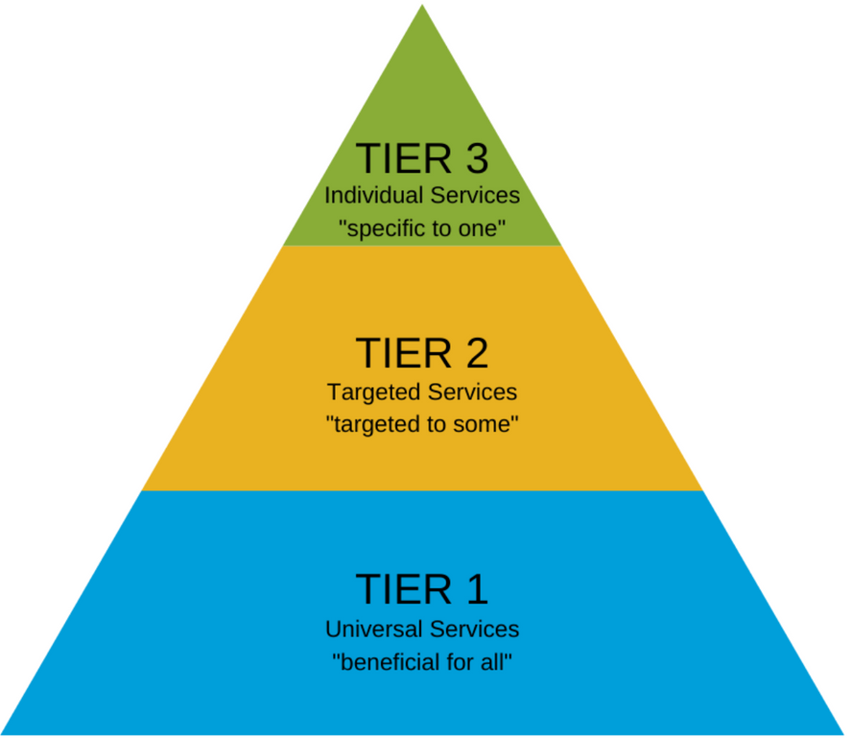
Addressing Needs at All Levels
Current TCMHCC School-Based Programs
TCHATT – Tier 3
Statewide implementation of YAM – Tier 1
We will build on the existing school-based programs by expanding our training opportunities to equip school personnel to identify and aid students at all levels of risk.

Slide 11
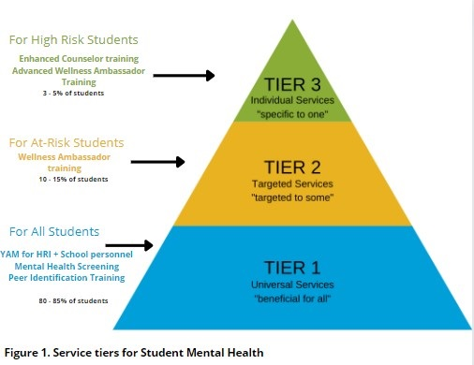
Programming at ALL Levels of Risk
Tier 1:
Continue YAM certification for TCMHCC HRI personnel to deploy to respective regions
Expanded and New CDRC Training available for any school:
YAM Certification for all school district personnel
Mental Health Screening
Identifying Peers in Need
Tier 2:
New Wellness Ambassador Training
Tier 3:
New Counselor Training Programs
Enhanced School Counselor Mental Health Training
Advanced Wellness Ambassadors Training

Slide 12
Wellness Ambassador Program
The primary goals of the Wellness Ambassadors will be to:
Identify students in need.
This will include not only students who are in crisis, but also those who are experiencing some levels of depression or anxiety or who are struggling with significant daily stressors in their home or academic environments.
Assist students and families in addressing acute needs.
This includes getting the student through the initial challenge at hand. In some instances, counselors will need to be involved, particularly if the student is a danger to him/herself or others.
Identify possible resources to address mental health or environmental stressors.
This will involve working with the student and family to determine needs, identify barriers to care, and link the families to the appropriate resources.
Ensure linkage to resources is successful.
This will require following up with students and families to ensure they followed through with care and that the resource is meeting their needs.

Slide 13
Wellness Ambassador Training
Confidentiality
Recognizing depression and anxiety
Coping strategies
Safety planning
Mindfulness techniques
Resource acquisition
Special populations and circumstances
Collaborating with students, counselors, parents, etc.
Recognizing personal biases

Slide 14
Counselor Training Program
In a recent survey by the ASCA, 94% of school counselors stated the were interested in receiving more training in mental health; 86% said they wanted more training on diversity, equity, and inclusion.
The CDRC Training Academy will develop a series of training programs for school counselors, including:
Brief intervention strategies, such as Safe Alternatives for Teens and Youth (SAFETY-A)
Measurement-based care models
Signs and symptoms of various mental illnesses
Evidence-based treatments for depression, anxiety, bipolar, etc.

