Slide 1
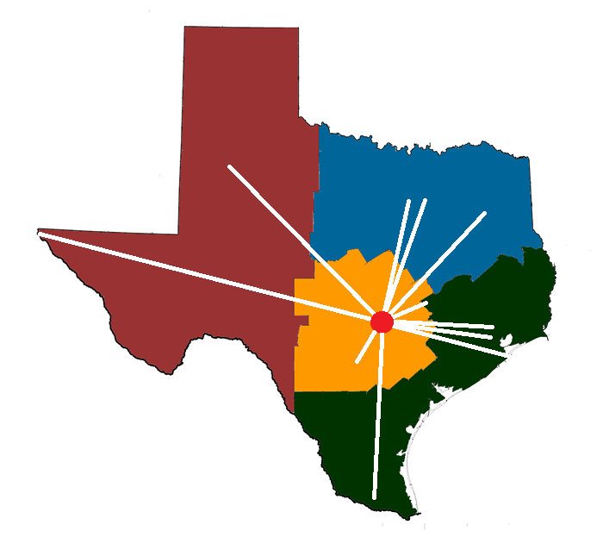
Texas Childhood Trauma Research Network TCMHCC Executive Committee Meeting February 28, 2022

Slide 2
Texas CTRN Cumulative Visits Thru 2/24/2022
N=1,122
N=915
N=505
N=154

Slide 3
Texas CTRN Completed Baseline Visits by Month Thru 2/24/2022
N=1,122
49

Slide 4
Texas CTRN Monthly Completed Baseline Visits by Node Thru 2/24/2022
Node | Oct | Nov | Dec | Jan | Feb | Mar | Apr | May | June | July | Aug | Sep | Oct | Nov | Dec | Jan | Feb | Mar | Total
UT SW |  | 9 | 14 | 15 | 16 | 20 | 21 | 20 | 18 | 11 | 6 | 6 | 10 | 5 | 6 | 4 | 6 |  | 187
UT Austin | 8 | 16 | 14 | 8 | 14 | 13 | 16 | 9 | 13 | 8 | 11 | 6 | 15 | 7 | 10 | 2 | 9 |  | 179
UT MB | 7 | 15 | 11 | 6 | 10 | 13 | 8 | 12 | 9 | 4 | 9 | 6 | 9 | 7 | 3 | 8 | 3 |  | 140
UT Htn |  | 7 | 2 | 9 | 6 | 7 | 7 | 5 | 16 | 14 | 13 | 11 | 8 | 4 | 5 | 5 | 2 |  | 121
UNT |  |  |  |  | 3 | 9 | 2 | 11 | 11 | 12 | 16 | 9 | 10 | 6 | 13 | 10 | 5 |  | 117
UT SA | 1 | 4 | 10 | 2 | 9 | 9 | 11 | 12 | 4 | 7 | 9 | 1 | 8 | 2 | 3 | 3 | 10 |  | 105
UT RGV |  |  |  |  |  | 3 | 4 | 4 | 8 | 5 | 19 | 9 | 10 | 10 | 7 | 9 | 7 |  | 95
Baylor |  |  |  | 1 | 0 | 6 | 2 | 4 | 3 | 8 | 6 | 5 | 8 | 7 | 1 | 5 | 4 |  | 60
TT El Paso |  |  |  | 7 | 11 | 9 | 5 | 10 | 3 |  |  | 3 | 1 | 1 |  | 4 | 2 |  | 56
TT Lubb |  |  |  |  |  |  | 1 | 4 | 4 | 2 | 4 | 4 | 5 | 1 | 4 | 3 | 1 |  | 33
Tex A&M |  |  |  | 2 | 2 | 3 | 3 | 5 |  | 1 | 1 | 1 | 4 |  | 1 | 1 |  |  | 24
UT Tyler |  |  |  |  |  |  |  |  | 1 | 1 | 1 | 1 | 1 |  |  |  |  |  | 5
TOTAL | 16 | 51 | 51 | 50 | 71 | 92 | 80 | 96 | 90 | 73 | 95 | 62 | 89 | 50 | 53 | 54 | 49 |  | 1,122
Pct Change |  | 219 | 0 | 2 | 42 | 30 | 13 | 20 | 6 | 19 | 30 | 35 | 44 | 44 | 6 | 2 | 1

Slide 5
Worst Trauma Exposed to death, threatened death, actual/threatened serious injury, actual/threatened sexual violence Thru 2/23/2022
N = 1,117
Percentage

Slide 6
Primary DSM-5 Diagnoses at Baseline Thru 2/23/2022
N = 1,117
Percentage

Slide 7
TX CTRN Approved Publications
Date Approved | Lead Author(s) Institution | Title | Date Data Provided
10/22/21 | C Dodd, K Wagner UTMB | Measurement invariance of PTSD symptom models in a diverse longitudinal study of trauma-exposed youth | 1/27/22
10/22/21 | J Shahidullah UT Austin | Establishing a training plan and estimating inter-rater reliability across a multi-site state-wide trauma research network | 2/11/22
1/26/22 | S Clark Texas A&M | Predictors of alcohol and substance use in trauma-exposed youth
2/11/22 | Sandoval J, Garrett A UT HSC San Antonio | Associations between ethnic identity, dissonance, and posttraumatic stress in youth

Slide 8
CTRN Publications Dodd C, Wagner K. Measurement invariance of PTSD symptom models in a diverse longitudinal study of trauma-exposed youth
History of PTSD Nosology
DSM-III: 3 primary features
DSM-IV: 3 symptom clusters
DSM-5: 4 symptom clusters
Factor analysis in adults suggests 5-, 6-, and 7-factor models may better represent PTSD symptoms
Item Mappings for PTSD Models​
Item​ |  | DSM-5​ | Dy​sphoria | Dysphoric Arousal | An​hedonia | Externalizing | Hybrid​
B1​ | Memories​ | Intrusion
B2​ | Dreams​ | Intrusion
B3​ | Flashbacks​ | Intrusion
B4​ | Cued distress​ | Intrusion
B5​ | Cued physical reactions​ | Intrusion​
C1​ | Avoiding int reminders​ | Avoidance
C2​ | Avoiding ext reminders​ | Avoidance
D1​ | Dissociative amnesia​ | NACM​ | Dysphoria​ | NACM​ | Neg. Affect​ | NACM​ | Neg. Affect​
D2​ | Negative beliefs​ | NACM​ | Dysphoria | NACM​ | Neg. Affect​ | NACM​ | Neg. Affect​
D3​ | Blame​ | NACM​ | Dysphoria | NACM​ | Neg. Affect​ | NACM​ | Neg. Affect​
D4​ | Negative feelings​ | NACM​ | Dysphoria | NACM​ | Neg. Affect​ | NACM​ | Neg. Affect​
D5​ | Loss of interest​ | NACM​ | Dysphoria | NACM​ | Anhedonia | NACM​ | Anhedonia​
D6​ | Detached/Estranged​ | NACM​ | Dysphoria | NACM​ | Anhedonia | NACM​ | Anhedonia
D7​ | Numbing​ | NACM​ | Dysphoria | NACM​ | Anhedonia | NACM​ | Anhedonia
E1​ | Irritability/aggression​ | Arousal/Reactivity​ | Dysphoria | Dysphoric Arousal |  | Externalizing Behaviors
E2​ | Reckless behavior​ | Arousal/Reactivity | Dysphoria | Dysphoric Arousal |  | Externalizing Behaviors
E3​ | Hypervigilance​ | Arousal/Reactivity |  | Anxious Arousal
E4​ | Startle​ | Arousal/Reactivity |  | Anxious Arousal
E5​ | Concentration​ | Arousal/Reactivity | Dysphoria | Dysphoric Arousal
E6​ | Sleep​ problems | Arousal/Reactivity | Dysphoria | Dysphoric Arousal

Slide 9
CTRN Publications Dodd C, Wagner K. Measurement invariance of PTSD symptom models in a diverse longitudinal study of trauma-exposed youth
Comparison of Overall Model Fit​​​​
Comparison​​​​ | Δ χ2​​​​ | Δdf​​​​ | ΔBIC​​​​
Dysphoric Arousal v. DSM-5​​​​ | 74.93*​​​​ | 4​​​​ | -​​​​
Anhedonia v. DSM-5​​​​ | 121.53*​​​​ | 9​​​​ | -​​​​
Externalizing v. DSM-5​​​​ | 81.39*​​​​ | 9​​​​ | -​​​​
Hybrid v. DSM-5​​​​ | 128.35*​​​​ | 15​​​​ | -​​​​
Dysphoric Arousal v. Dysphoria​​​​ | 7.37​​​​ | 4​​​​ | -​​​​
Anhedonia v. Dysphoria​​​​ | 55.82*​​​​ | 9​​​​ | -​​​​
Anhedonia v. Dysphoric Arousal​ | 47.54*​​​​ | 5​​​​ | -​​​​
Externalizing v. Dy​​​​sphoria | 13.72​​​​ | 9​​​​ | -​​​​
Hybrid v. Dy​​​​sphoria | 62.30*​​​​ | 15​​​​ | -​​​​
Hybrid v. Dysphoric Arousal | 54.59*​​​​ | 11​​​​ | -​​​​
Hybrid v. Anhedonia | 6.34​​​​ | 6​​​​ | -​​​​
Hybrid v. Externalizing | 47.20*​​​​ | 6​​​​ | -​​​​
Dysphoria v. DSM-5​​​​ | -​​​​ | -​​​​ | 99.65​​​​
Externalizing v. Anhedonia | -​​​​ | -​​​​ | 64.01​​​​
Note. df = degrees of freedom; BIC = Bayesian Information Criterion; * p < .001. ​​
Conclusions
All models with good fit
Alternative models with significantly better fit than 4-factor DSM-5 model
Best fit: 6-factor Anhedonia and 7-factor Hybrid models
Both DSM-5 and Hybrid models were equivalent across gender, age, ethnicity
Overall, PTSD symptoms among youth may be best represented by models recognizing Anhedonia and Externalizing Behaviors

Slide 10
CTRN Publications Shahidullah J. Establishing a training plan & estimating inter-rater reliability across a multi-site state-wide trauma research network
Traumatic Event | Kappa Scores
 | Trauma Occurred | Fulfilled DSM5 Criterion A
Accident Experienced | 0.90 | 0.75
Accident Witnessed | 0.91 | 0.67
Natural Disaster Experienced | 0.84 | 0.72
Friend/Fam Severely Ill | 0.88 | 0.65
Surgery / Hospitalization | 0.88 | 0.72
Separated from Family | 0.75 | 0.61
Physical Abuse / Attack | 0.78 | 0.76
Threatened Violence | 0.94 | 0.79
Mugged/Robbed/Theft | 0.85 | 0.33
Kidnapped | 0.94 | 0.79
Attacked by Animal | 0.90 | 0.85
Witness Household Violence | 0.97 | 0.85
Witness Household Threats | 0.85 | 0.50
Family Imprisonment | 0.78 | 0.13
Witness Community Violence | 0.82 | 0.68
Witness Community Threats | 0.80 | 0.68
Media Violence/Trauma | 0.54 | 0.07
Sexual Abuse | 0.88 | 0.76
Other | 0.78 | 0.92
Bullying | 0.90
Cyberbullying | 0.87
Kappa Score Key
Almost Perfect 0.81-1.00
Substantial 0.61-0.80
Moderate 0.41-0.60
Fair 0.21-0.40
None to Slight 0.01-0.20

Slide 11
CTRN Publications Shahidullah J. Establishing a training plan & estimating inter-rater reliability across a multi-site state-wide trauma research network
Kappa Score Key
Almost Perfect 0.81-1.00
Substantial 0.61-0.80
Moderate 0.41-0.60
Fair 0.21-0.40
None to Slight 0.01-0.20
Level | Type
 | Experienced | Witnessed
Trauma Occurred | 88 | 83 | 87
DSM 5 Criterion A | 76 | 66 | 72
 | 82 | 73 | 79

