Slide 1


COSH February 2022 Report
Laurel L. Williams, DO
Edith Ortiz, MBA
Jennifer Evans

Slide 2
COSH Order of Business
COSH updates
CPAN
TCHATT
Data Governance

Slide 3
COSH UPDATES
Microsoft Teams for TCHATT and CPAN
Transferred all documents, The BOX to MT
Centralized platform for all teams to access information
CPAN Manual:
Received first draft back from teams
Currently on revision
Final copy will be place in Microsoft team CPAN page
New COSH team member:
Romel Walker, COSH Data Analyst

Slide 4
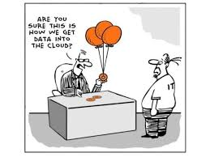
Data Governance Committee
Data Governance Council Updates
    Drs. Pliszka and Vo
    Meets weekly
    No updates beyond the excitement that Mr. Walker arrived in January for the Sr. Data Analyst Role for COSH

Slide 5
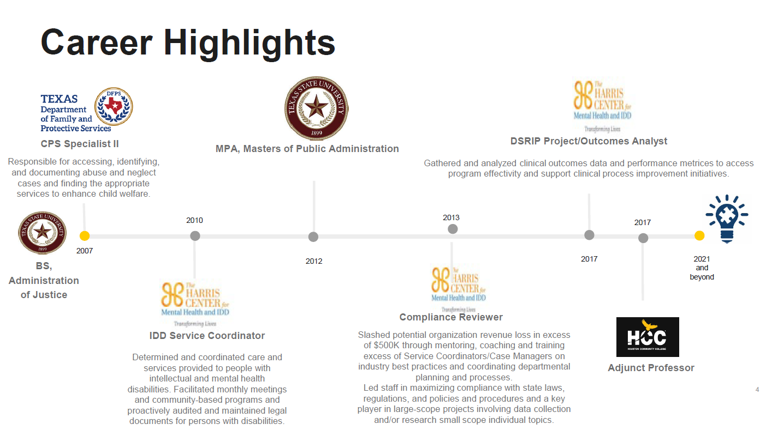

Slide 6


Slide 7
CPAN UPDATES
Spring Project ECHO begins in April 2022
6 sessions:
  Assessment of Aggression and Anger
  Out of Control Kids – How to advise Parents
  Management of Chronic Illness
  Psychological vs. Neuropsychological Assessment When to ask for What
  Eating Disorders
  Suicide Assessment and Safety Planning
ECHO is a collaborative team-based learning model- expectation is smaller group and review of cases
Allows us to lean on State experts to help develop content
Feedback from participants related to high yield topics
Enhances consistency in teaching as all teams teach from the SAME material

Slide 8
CPAN UPDATES
  ARPA Funding Projects High Level TRAYT
    Add new features
      Direct Care Consultation Process Data Collection
      Web and APP Portal for PCP to more seamlessly request consultation and be provided documentation related to consultations
    Develop CPAN for Moms (Peri-Pan)
      COSH working with the Peri-Pan Leadership Team
    Add new data items to report for ARPA
      Texting, app based, email, phone
      Information related to direct consultation for CPAN
      CPAN for Moms Insight Dashboard-similar to CPAN dashboard

Slide 9

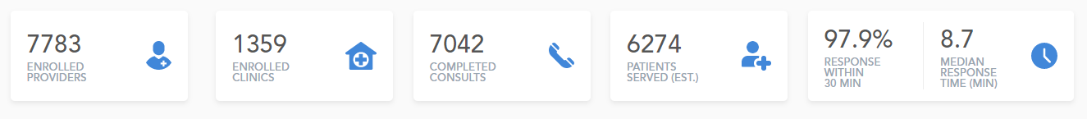
CPAN Overview

Slide 10
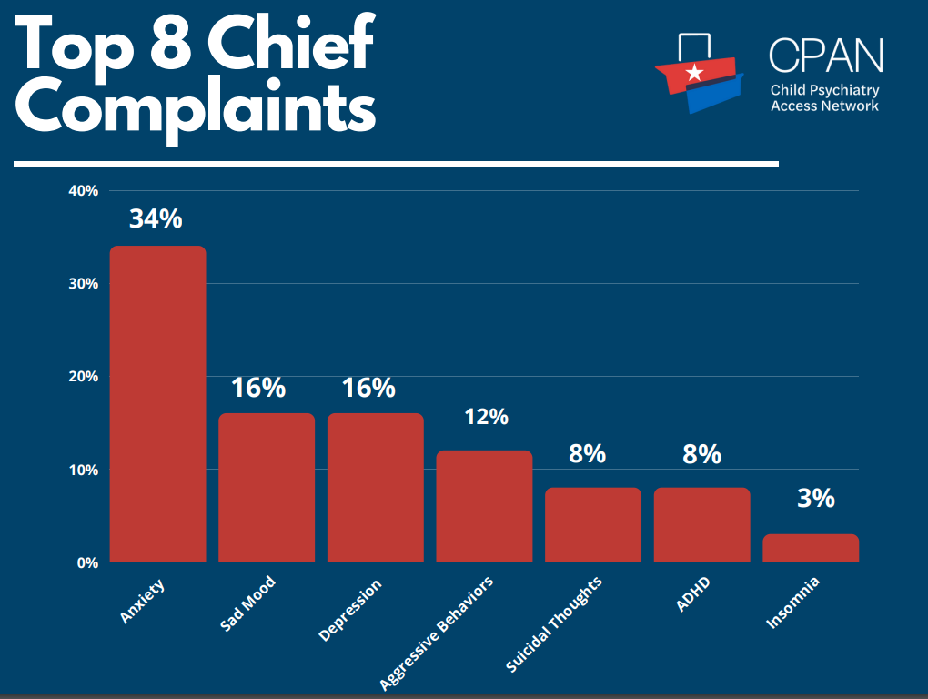

Slide 11
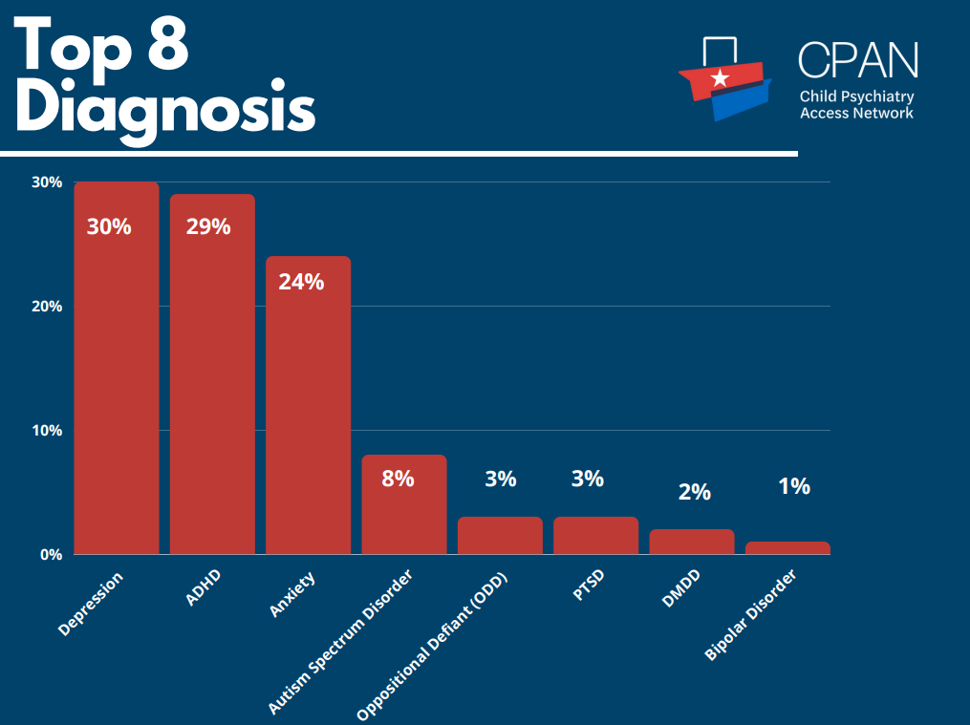

Slide 12
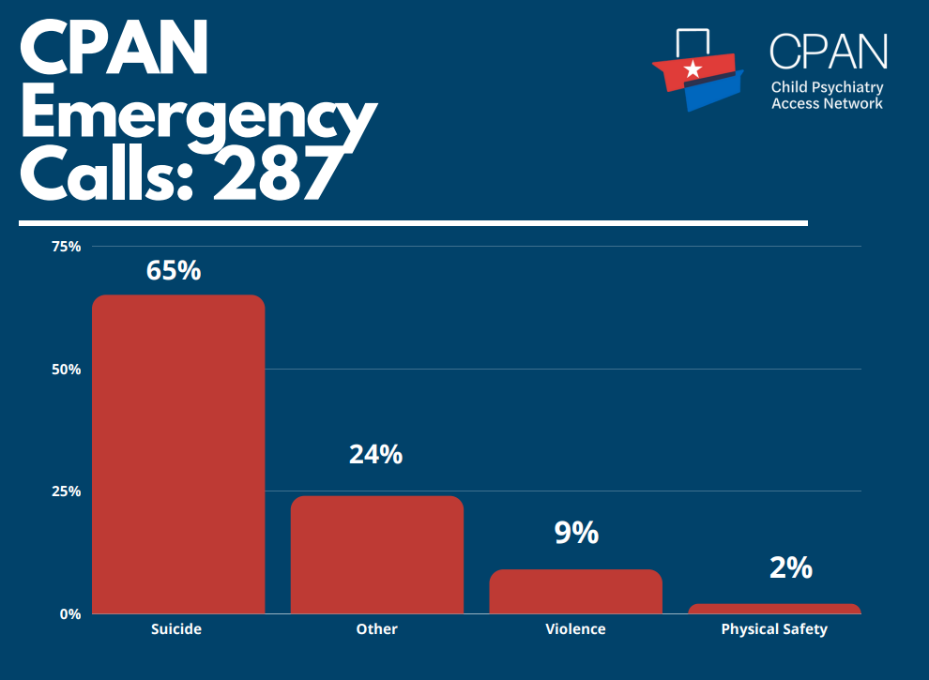

Slide 13


Slide 14
TCHATT UPDATES
  TCHATT Data Review for the first 3 months of school (August-October 2022)
  Reviewing youth who had their TCHATT referral in this time frame
  N= 3442 preliminary total in those 3 months
  N= 2435 preliminary total ENROLLED that have gotten to END of service
  We picked this first batch to review as the expectation was that most youth who were referred and enrolled during these 3 months would have likely completed TCHATT services
  As the data is reviewed further, more details to follow.
  Trend from this year to last is an increase in the number of referrals from the previous year

Slide 15
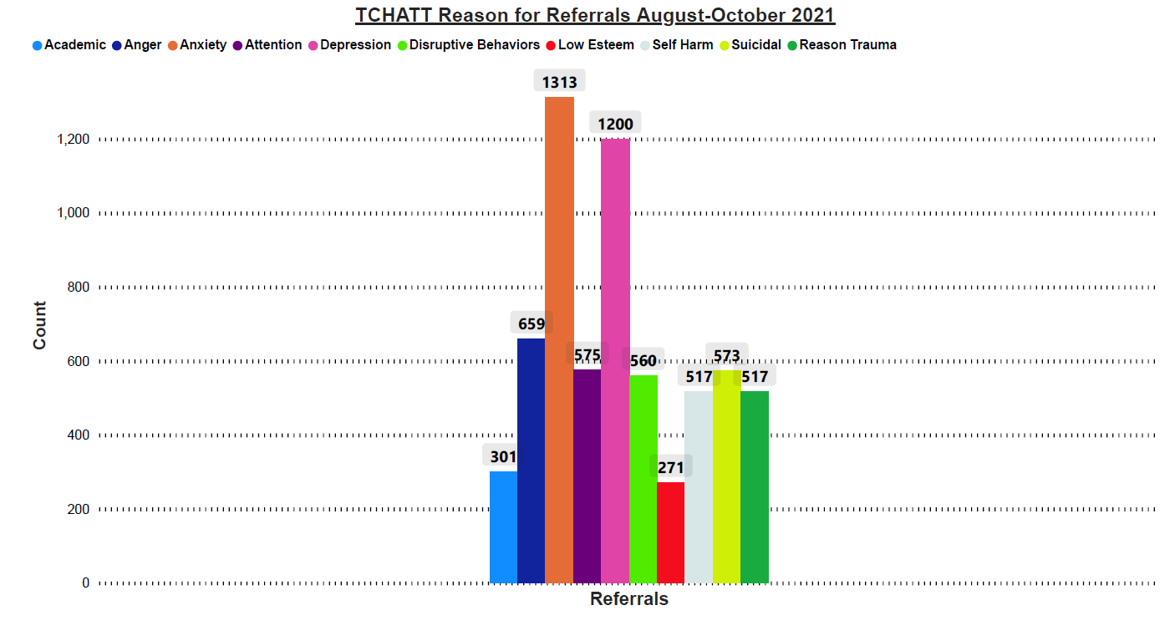


Slide 16
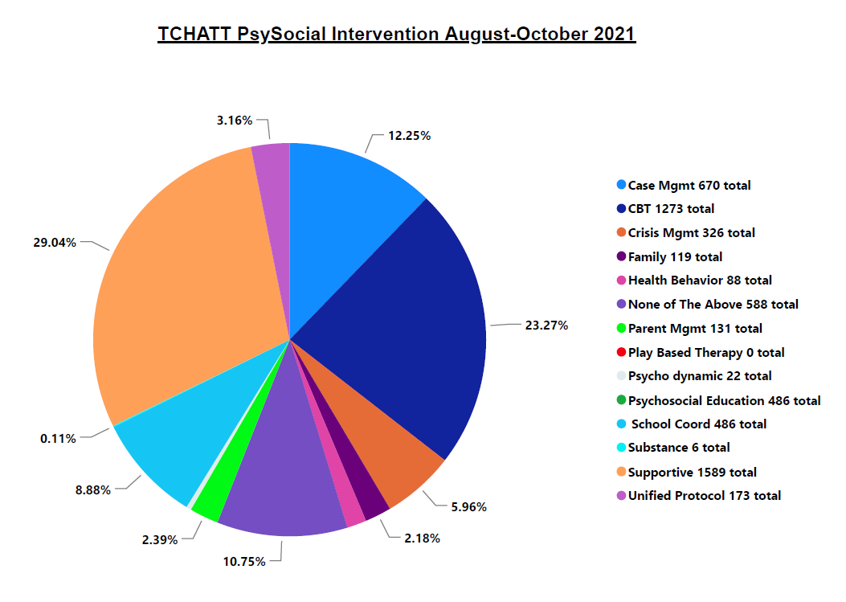
Notes:
416 (67%); 155 (25%); 31 (5%); 12 (2%); 6 (1%)

Slide 17
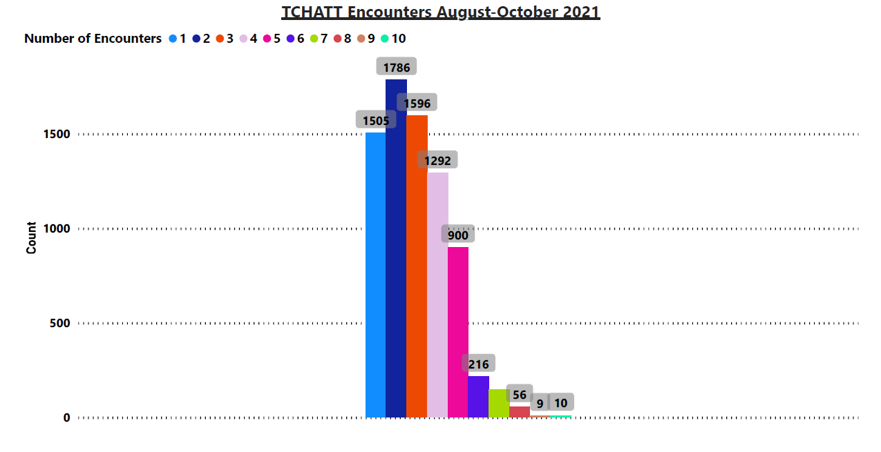

Slide 18
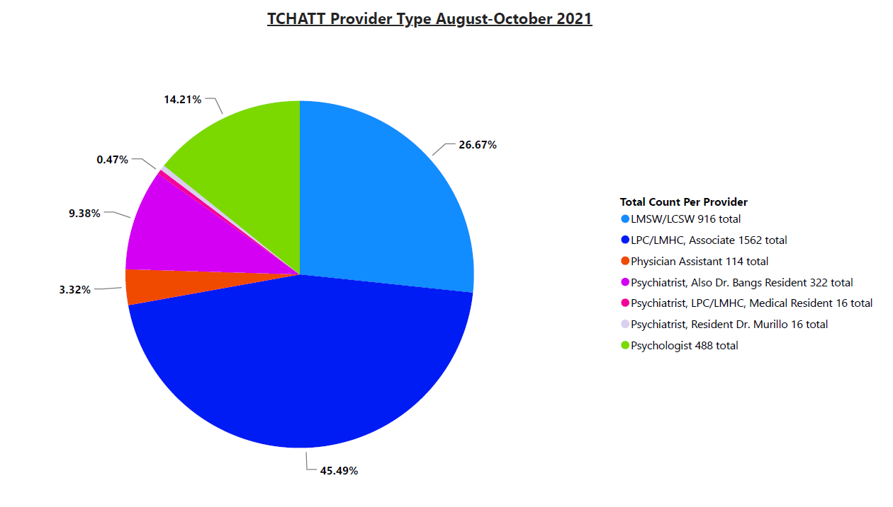

Slide 19



