Slide 1
Texas Child Mental Health Care Consortium
Melanie Susswein, MSW

Slide 2
1
CHC Overview
2
Project Overview
3
CPAN
4
Q&A
Agenda

Slide 3
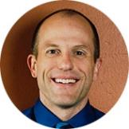
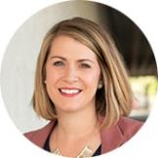
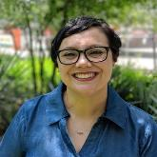
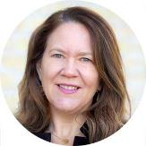
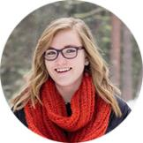
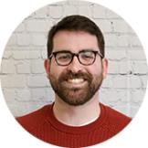
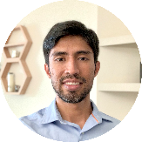
OUR team
Mike Mackert
Director
Jessica
Hughes Wagner
Deputy Director
Patricia Semenov
Center Administrator
Melanie Susswein
Program Manager
Nicole Kirschten
Graphic Designer
Nick Brothers
Copywriter
Eddie Silva
Web Developer

Slide 4


Slide 5
Notes:
CHC Message Design Process

Slide 6
TCMHCC Project Aims
CPAN
Increase number of newly enrolled PCPs.
Increase utilization of CPAN services by enrolled PCPs.
TCHATT
Increase utilization of TCHATT services by currently enrolled schools.
*Specific measurable goals and targets developed in collaboration with UTS and COSH for the communication evaluation plan.​

Slide 7
timeline
FALL 2021
Fall +
Winter 2021
Spring +
Summer 2022
Fall +
Winter 2022
Project onboarding
Information gathering
Formative research
Initiating creative development
Formative research
Develop and refine outreach and communication plan
Collaborate with physician engagement expert
Provide HRIs with initial tools and strategies
Direct mail distribution
Digital ads in market
Paid search/keyword marketing
Paid partnerships
Overview video launch
Continued engagement and implementation of communication plan
Evaluation plan

Slide 8
STRATEGY + TACTICS
Tactics and strategies emerging from our research:
Direct Mail | Paid Partnerships | Digital Ads | Email
Website | Events | Video | SEO + Marketing

Slide 9

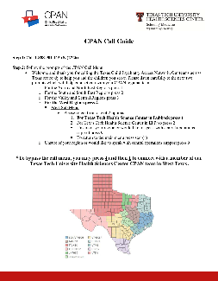



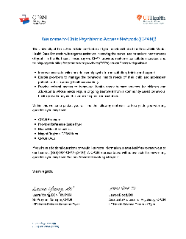


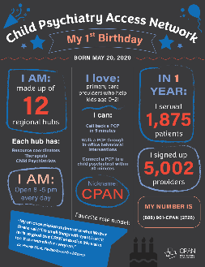

Thus Far- focus on
CPAN

Slide 10
Activities Thus Far
Background
Environmental scan of CPAN ecosystem
Engagement Strategy Review
Review of website and social
media platforms​
Meetings
Physician consultant
COSH touch point
Project meetings
Data management
HRI Individual Meetings with COSH
CME
ECHO

Slide 11
Activities Thus Far
Formative Research
Interviews with each HRI
Interview with Physician outreach consultant
Interviews with providers (in progress)
Interviews with national CPAN experts (in progress)
Creative
Review of existing materials and brand guides
Developed initial social media themes

Slide 12
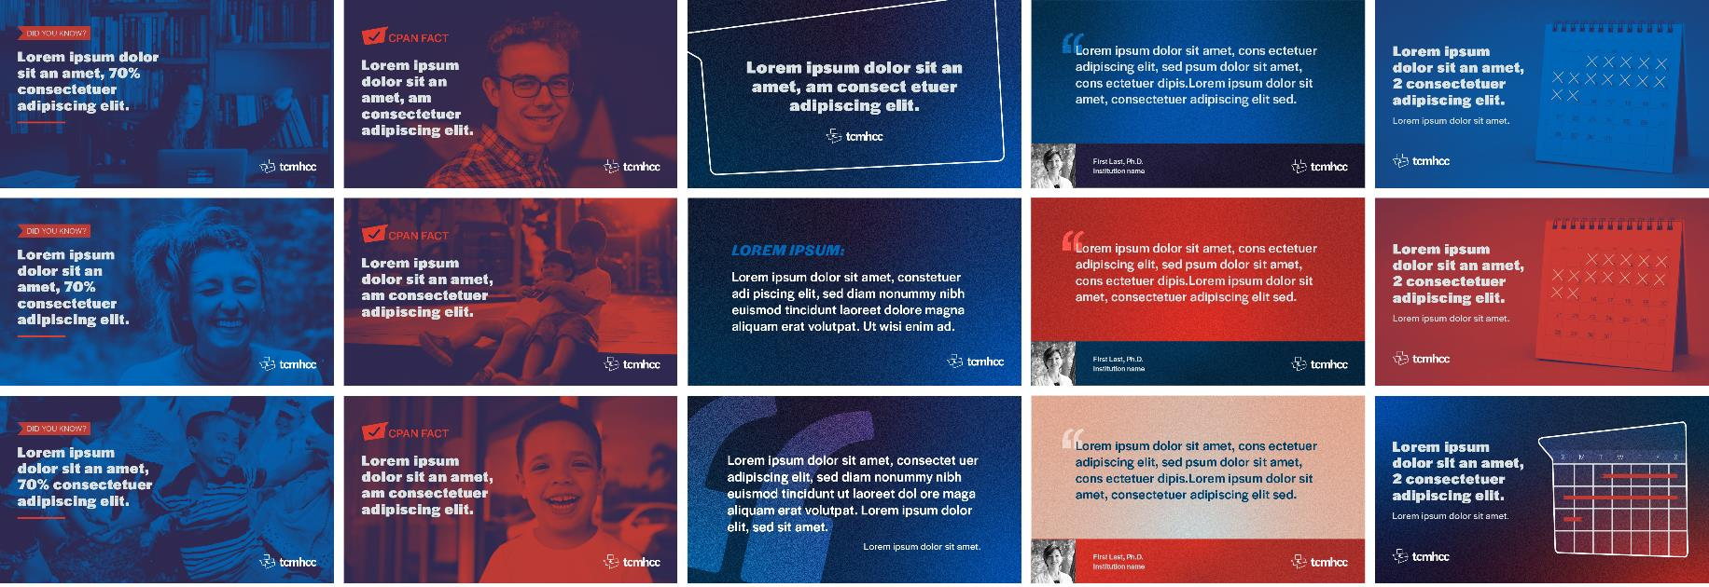
Social media templates – draft
Did you know?
CPAN Fact
In the Media
Endorsement
CME

Slide 14
Q & A

